Slide 1
Research assessment and openness
– a multi-faceted relationship
PUBMET2024
Bianca Kramer
@akademienl.social/@MsPhelps
Open science. Open metadata. Open infrastructure
https://tinyurl.com/pubmet-2024-kramer

Slide 2
Perspectives on research assessment
Why
Allocation of research budgets
Decisions on hiring, promotion and tenure
University reputation
Align assessment practices with the core values of the institution and the system as a whole
What kind of institutions do universities want to be ?

Slide 3
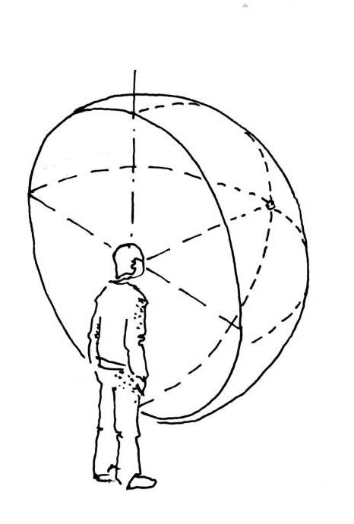
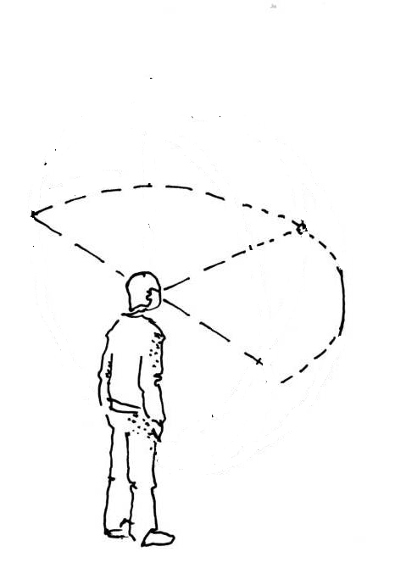
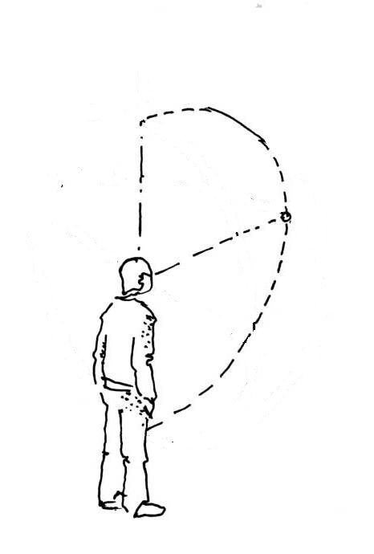
Perspectives on research assessment
What - broadening and widening
image adapted from 03-perspective sphérique

Slide 4
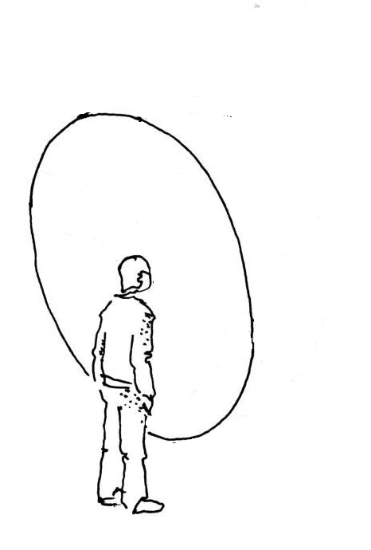
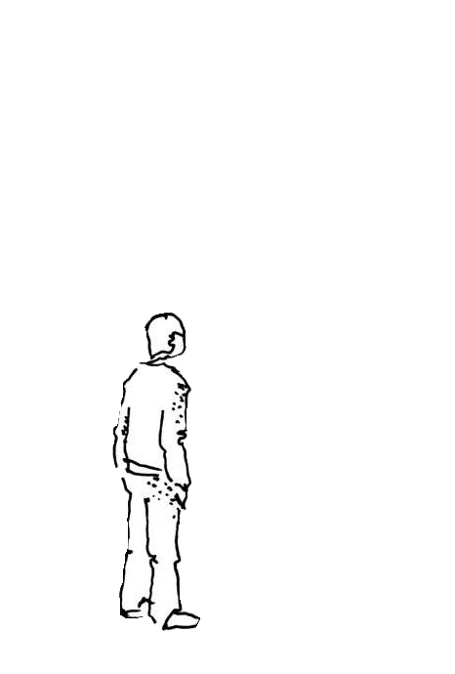
Perspectives on research assessment
How - the lenses we use
image adapted from 03-perspective sphérique

Slide 5
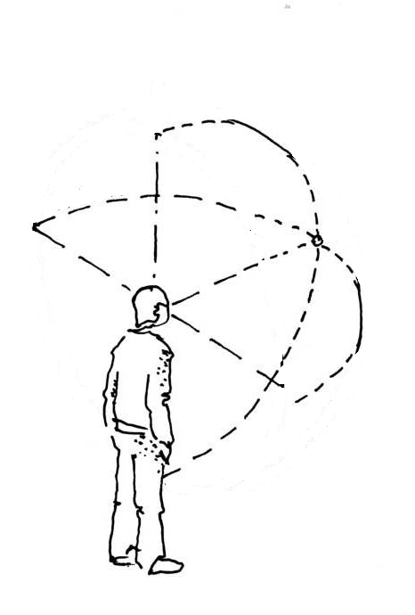
Broadening and widening
For the purposes of research assessment, consider the value and impact of all research outputs (including datasets and software) in addition to research publications
Consider a broad range of impact measures including qualitative indicators of research impact, such as influence on policy and practices

Slide 6
Broadening and widening
Look at research activities, not just research outcomes
Knowledge
dissemination
Research lines / prioritization
Research
process
Research design

Slide 7
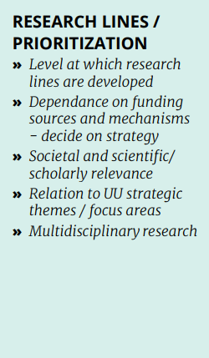
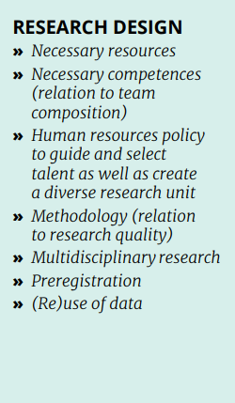
Broadening and widening
Knowledge
dissemination
Research lines / prioritization
Research
process
Research design
Utrecht University: Recognition & rewards - conversational guidelines

Slide 8
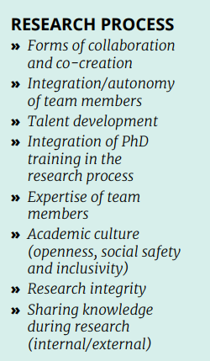
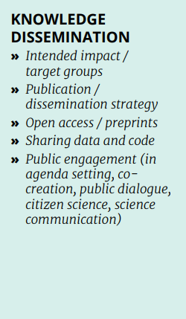
Broadening and widening
Knowledge
dissemination
Research lines / prioritization
Research
process
Research design
Utrecht University: Recognition & rewards - conversational guidelines

Slide 9
Broadening and widening
Also look at research activities, not just research outcomes
linked to strategic goals (more formative assessment)
context-specific choices (accounting for disciplinary differences)
choices made collectively (at level of research groups, departments, faculties)
safeguarding good research practices
Knowledge
dissemination
Research lines / prioritization
Research
process
Research design

Slide 10
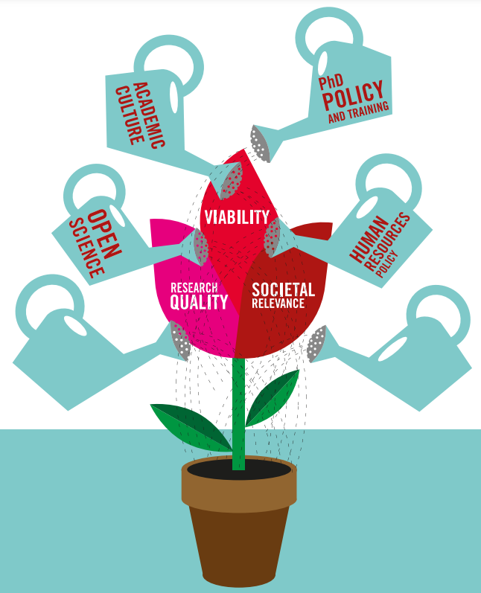
Example: Dutch Strategy evaluation protocol (SEP)
Evaluation in relation to the unit’s strategy
Criteria: research quality, societal impact and viability
Specific aspects:
Open science practices and efforts
PhD policy and training
Academic culture (openness, safety, inclusiveness, research integrity)
Human resources policy (diversity, talent management)
Narratives, supported by data (free choice of indicators)

Slide 11
Choosing indicators - a balancing act
What’s the balance between relevant (context-dependent) and comparable?
relevant
comparable
relevant
comparable

Slide 12
Choosing indicators - a balancing act
What’s the balance between relevant (context-dependent) and comparable?
broader spectrum of activities, outputs and indicators
more agency for those being assessed
vs.
more standardized requirements for outputs and metrics to be used
relevant
comparable
relevant
comparable

Slide 13
Choosing indicators - a balancing act
OPUS Research Assessment Framework (RAF)
comparable
Open Science Indicator Handbook
relevant
Open Science Assessment Framework (OSAF)

Slide 14
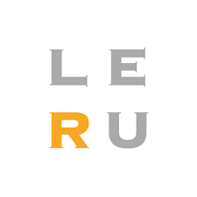
Choosing indicators - a balancing act
Next Generation Metrics for Scientific and Scholarly Research in Europe (position paper)
comparable
relevant
Bosman, Jeroen (2024). Changes in demand and supply of metrics for research evaluation in the context of open science and new R&R. Zenodo. https://doi.org/10.5281/zenodo.10569961

Slide 15
Changes in demand and supply of metrics for research evaluation in the context of open science and new R&R
stakeholders in
academia …
… are introducing changes, including …
… leading to potential new
demands for indicators/metrics …
… that partly match with …
… new types and characteristics
of metadata & metrics…
… from supplying parties.
OPEN SCIENCE & SCHOLARSHIP
MEASURING DIFFERENT THINGS
more inclusive databases (doctype/lang./geogr.)
open access, for people and machines, to:
materials, protocols
data that is also FAIR
code & software
publications (incl. preprints, proceedings)
while striving for:
full documentation of process
applying open reuse licenses
using open source software and hardware
involving stakeholders (incl. citizen science)
public engagement
adding plain language
open access status of outputs
OA-detection (e.g. UPW, including OA-types)
data FAIRness and availability/reuse
PLATFORMS
(e.g. Zenodo, Science Direct Github, bioRxiv)
UNIVERSITIES
code & software availability/reuse
open reuse license detection
preprinting
data of research/output mentions beyond academia
conference output
(sub)organization PIDs (ROR)
D
E
M
A
N
D
books, chapters
S
U
P
P
L
Y
output PIDs (DOI, URN, etc.)
REGISTRIES
(e.g. Crossref, DataCite, ROR, ORCID, DOAJ)
outputs in all languages
?
(societal) impact
creator PIDs (ORCID)
FUNDING
ORGANIZATIONS
collaborations
project PIDs (RAID)
RECOGNITION & REWARDS
funding/funder PIDs (funder registry, grant IDs)
recognize:
diversity of outputs
peer review
teamwork
collaboration
leadership
diversity of roles
(societal) impact
while striving for:
qualitative assessment
no journal based metrics
not only author-based metrics
involving the assessed
data/method transparency
community tool ownership
MEASURING THINGS DIFFERENTLY
data at team level
role indicators (e.g. using CREDIT taxonomy)
AGGREGATORS
(e.g. OpenAire, OpenAlex, CORE)
data at project level
open citations (COCI) and open abstracts (I4OA)
community control & ownership of tools
data/software/preprint citations (bidirectional)
data supporting formative assessment
avoid ranking of data
tools providing open granular data (API/dumps)
GOVERNMENTS
avoid composite metrics
open source tools (e.g. OpenAlex)
SERVICES
(e.g. WoS, Dimensions, LENS, Leiden Ranking)
fully open and transparent data
community governed tools/data (e.g. Crossref)
more qualitative data/insights
AI-based analyses/data

Slide 16
Trust markers for research assessment ?
Scientific / scholarly trust
Peer review / endorsement
Presence of methodological trust markers
Metadata trust
comparable
relevant
Data sources / records in data sources
Paolo Manghi; Challenges in building scholarly knowledge graphs for research assessment in open science. Quantitative Science Studies 2024. https://doi.org/10.1162/qss_a_00322

Slide 17
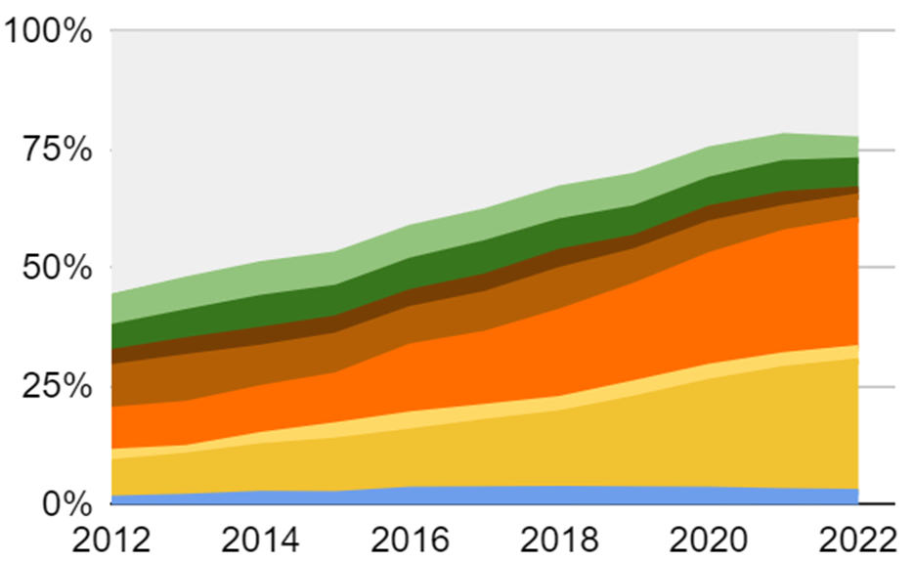
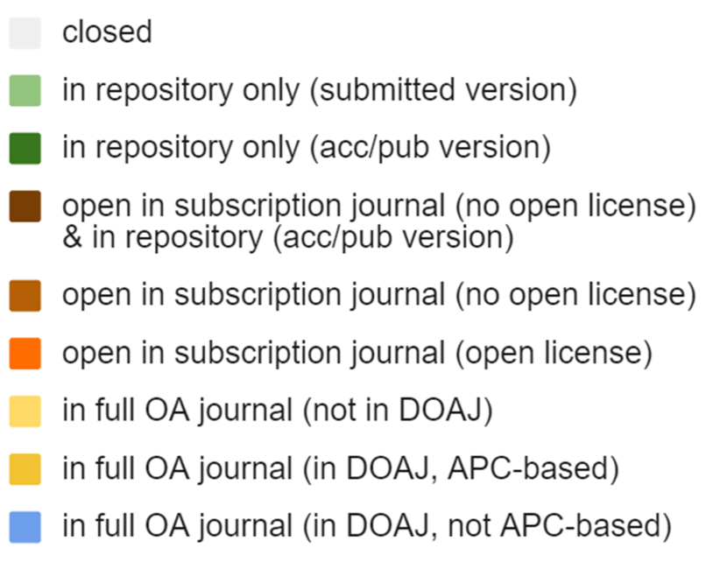
Example: OA journals - DOAJ
Country X
European Commission: Directorate-General for Research and Innovation and Kramer, B., Study on scientific publishing in Europe – Development, diversity, and transparency of costs, Publications Office of the European Union, 2024, https://doi.org/10.2777/89349

Slide 18
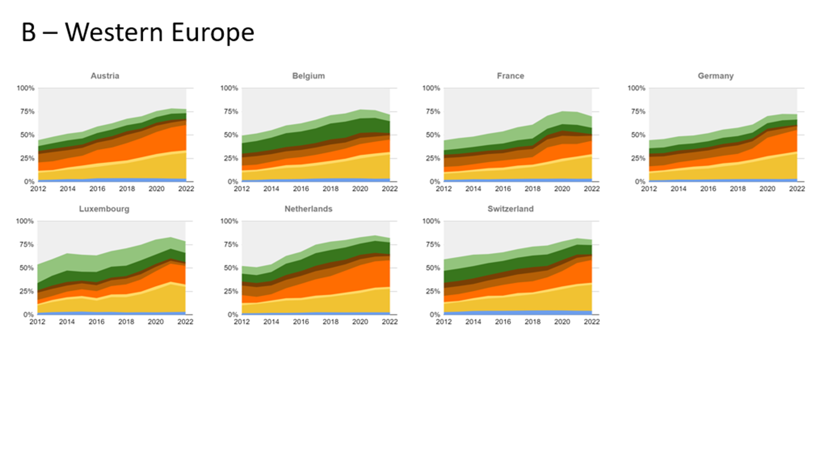
Example: OA journals - DOAJ

Slide 19
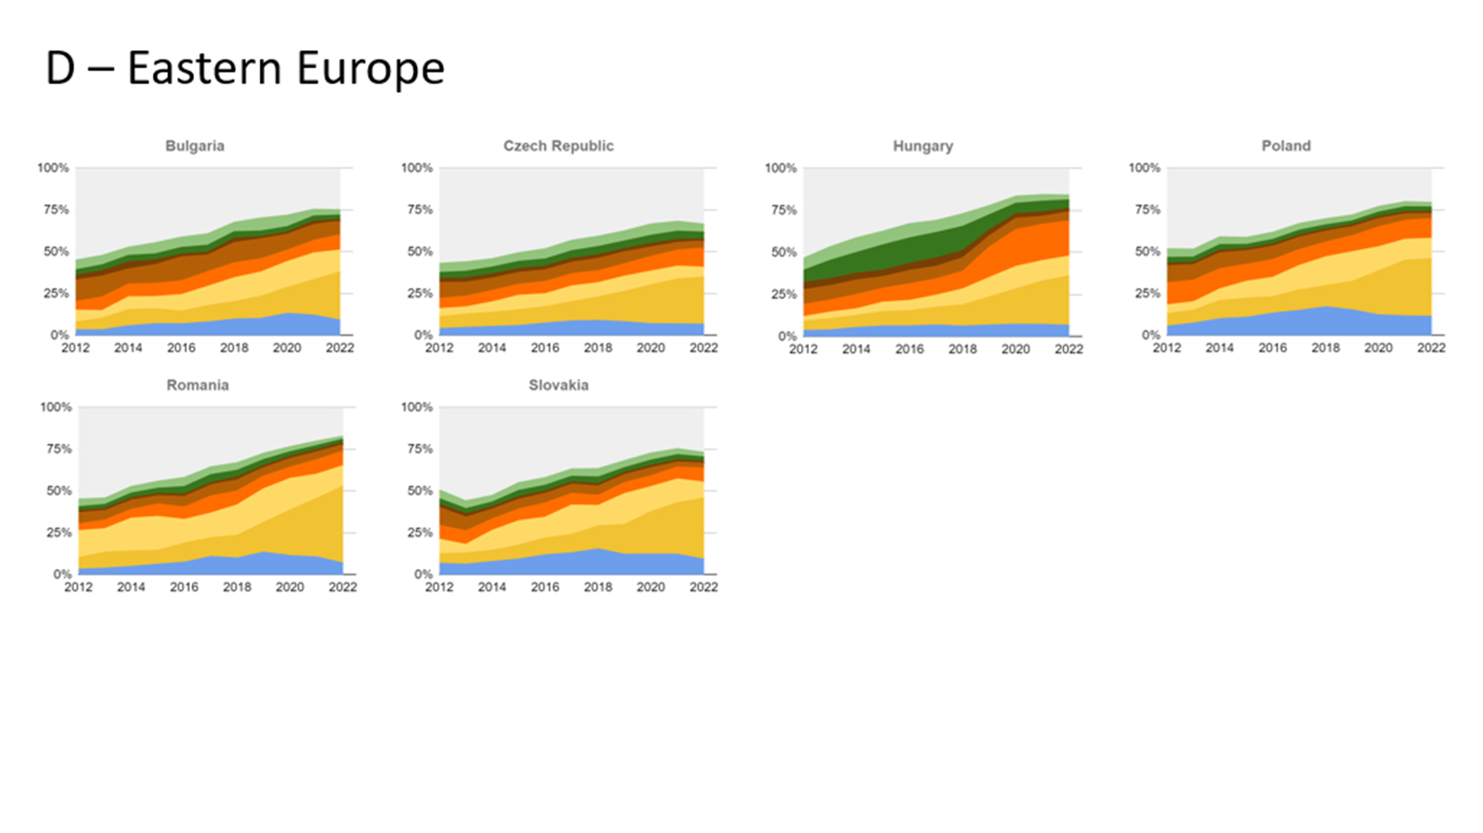
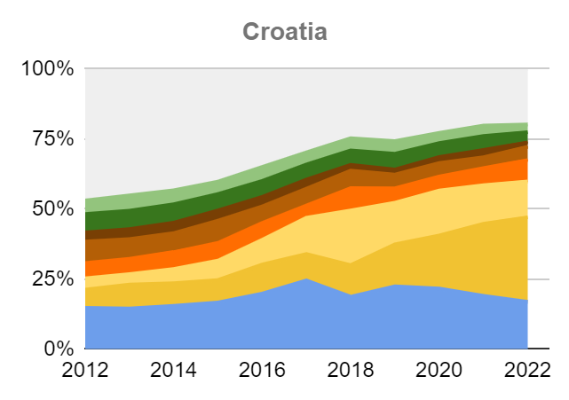
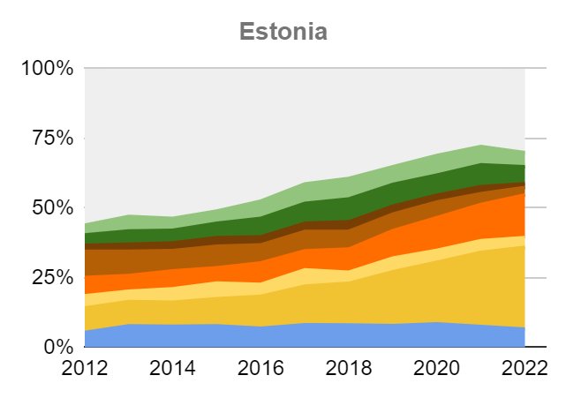
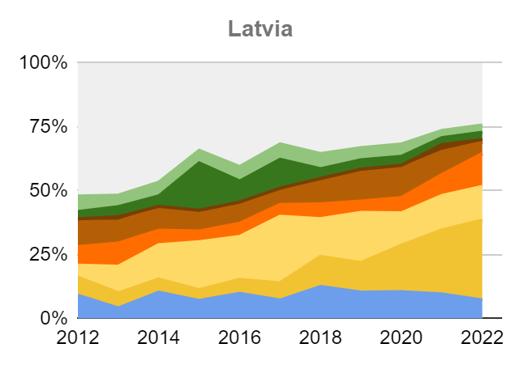
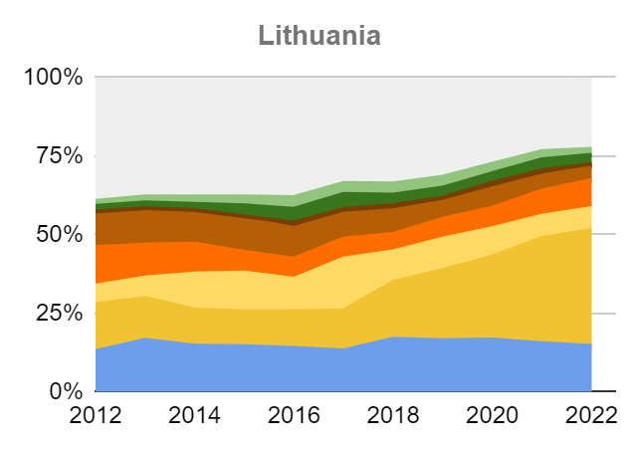
Example: OA journals - DOAJ

Slide 20
Perspectives on research assessment
How - the lenses we use

Slide 21
How - the lenses we use
Who do we give control over information on research outputs and impact ?
How open and inclusive are the data and infrastructure we use ?
How - the lenses we use

Slide 22
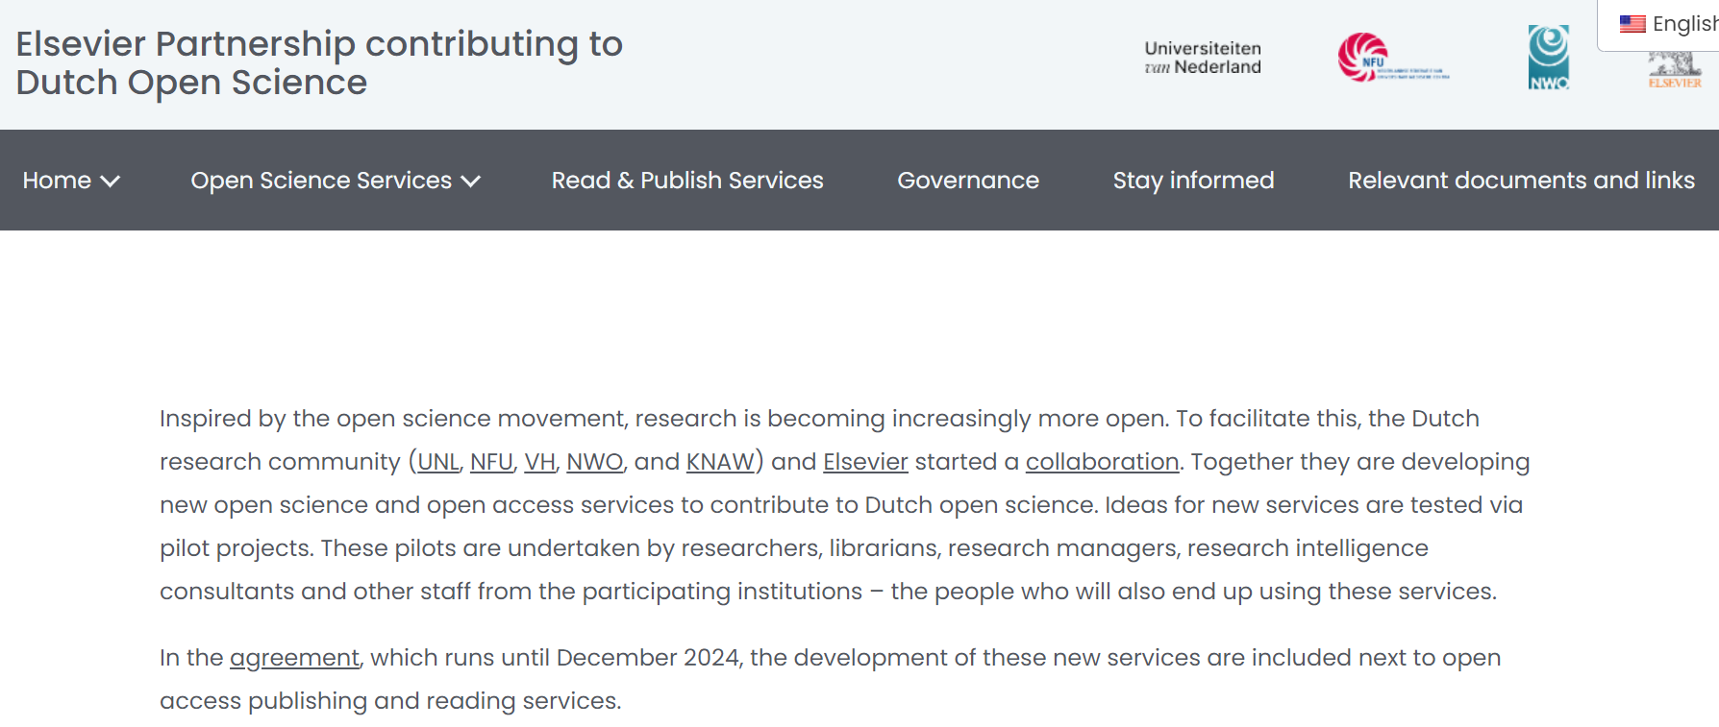
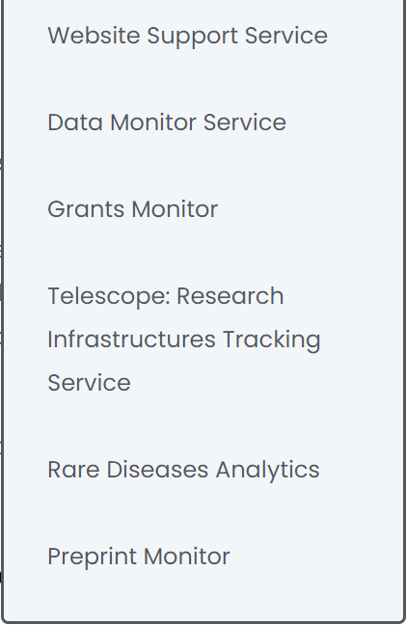
Like this ?
see also: https://doi.org/10.5281/zenodo.6074944
https://www.universiteitenvannederland.nl/en_GB/publieke-waarden-en-academische-soevereiniteit.html

Slide 23
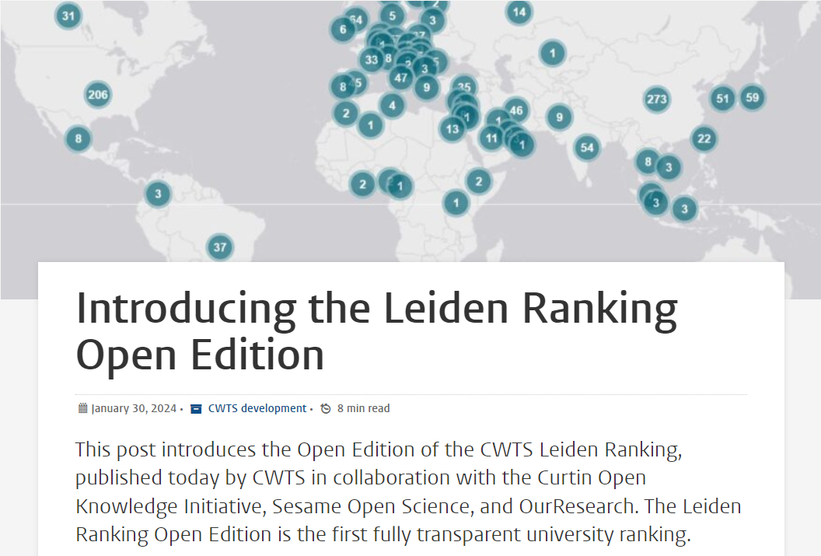
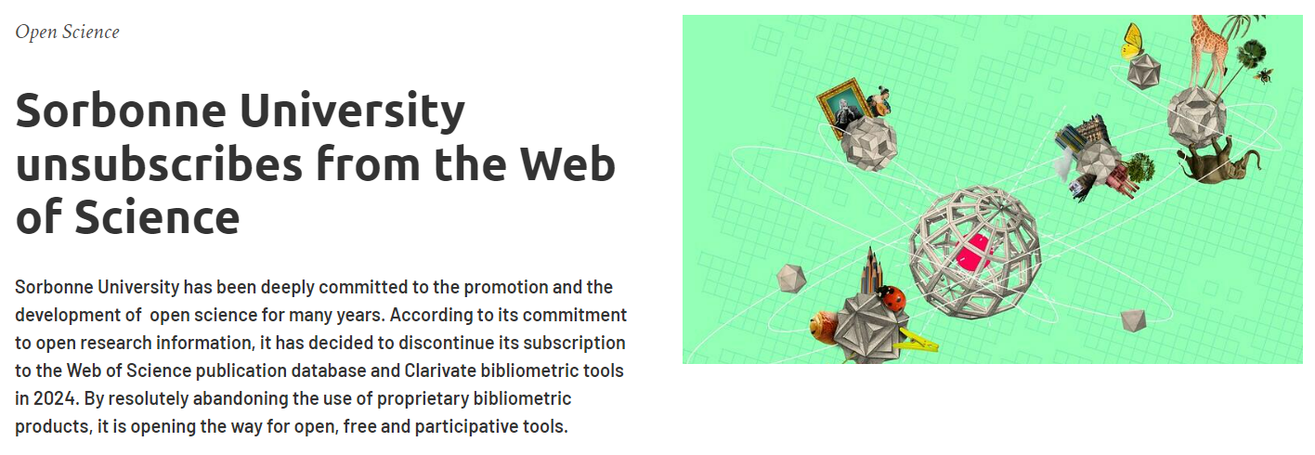
Or like this ?

Slide 24
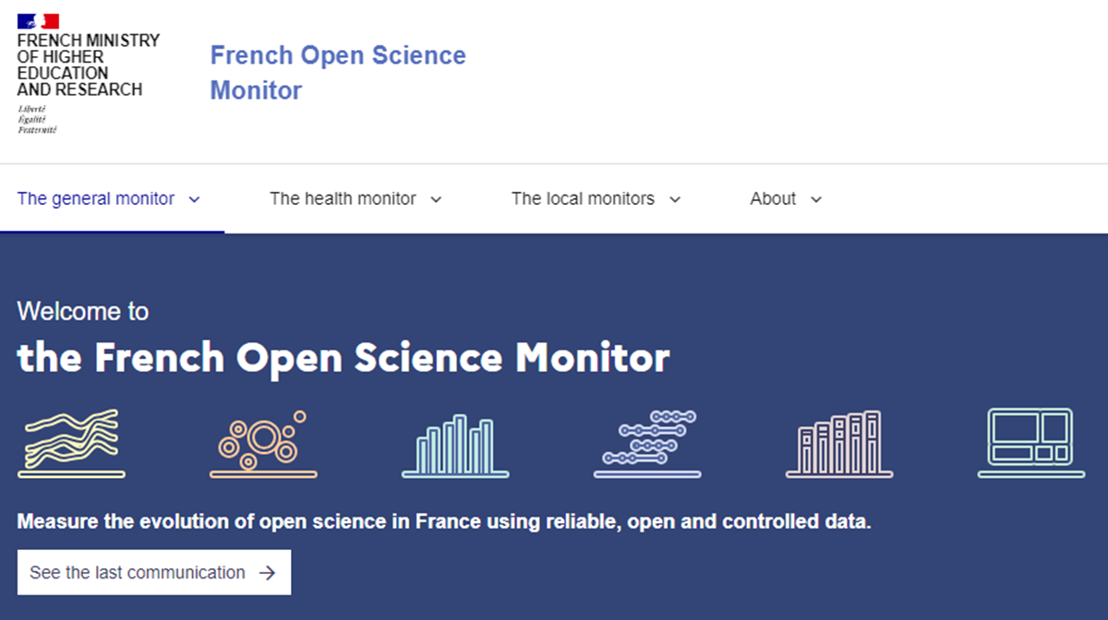
And like this ?

Slide 25
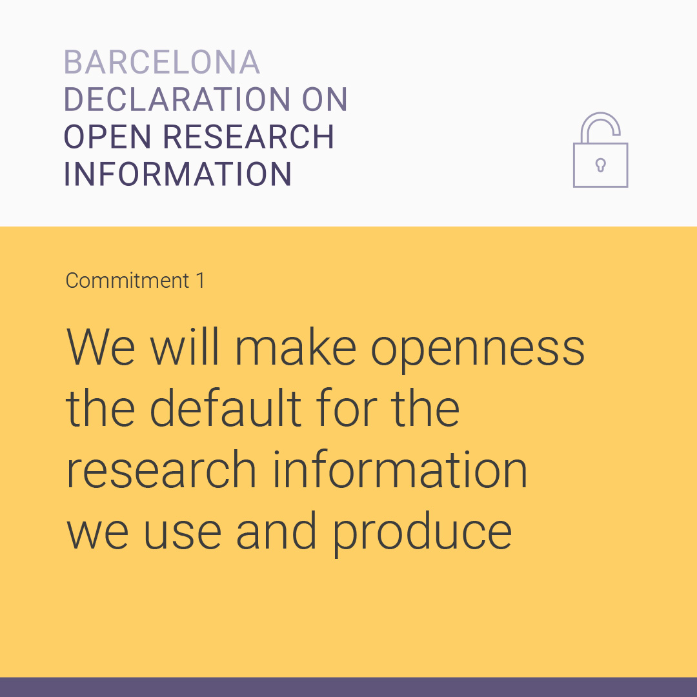
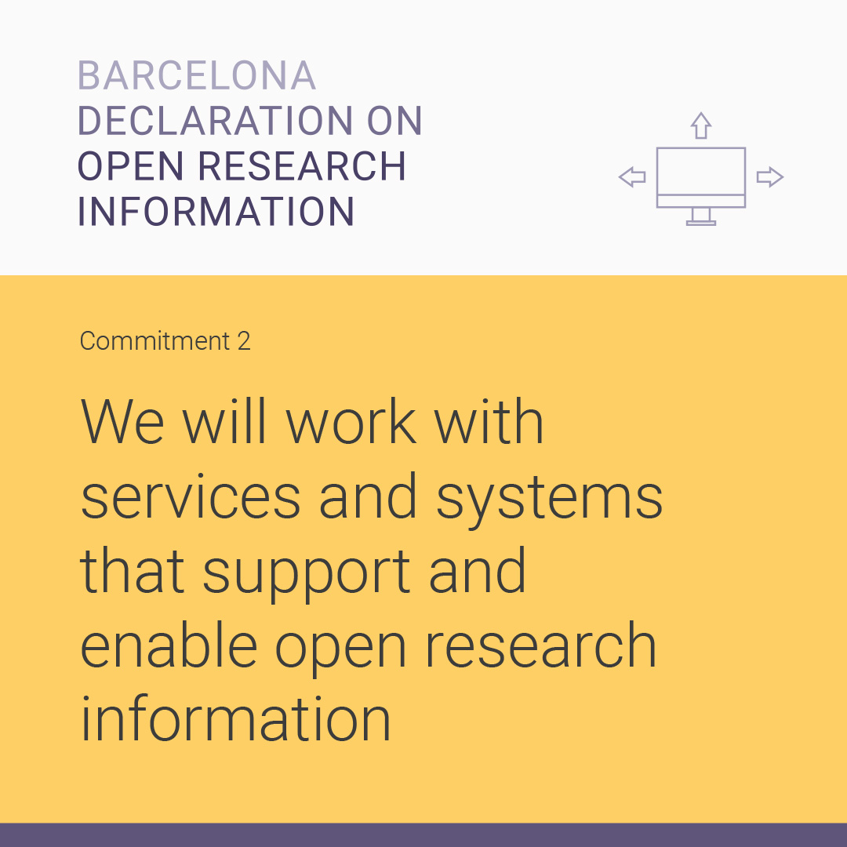
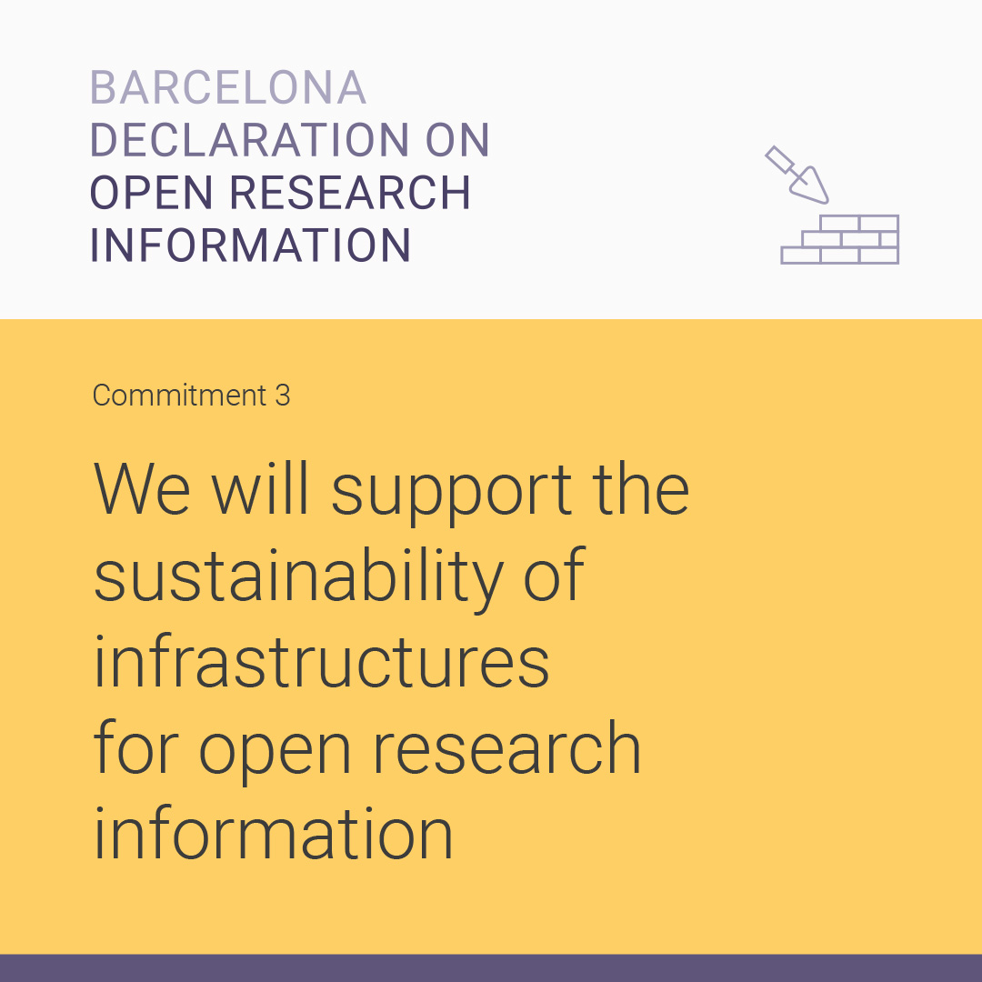
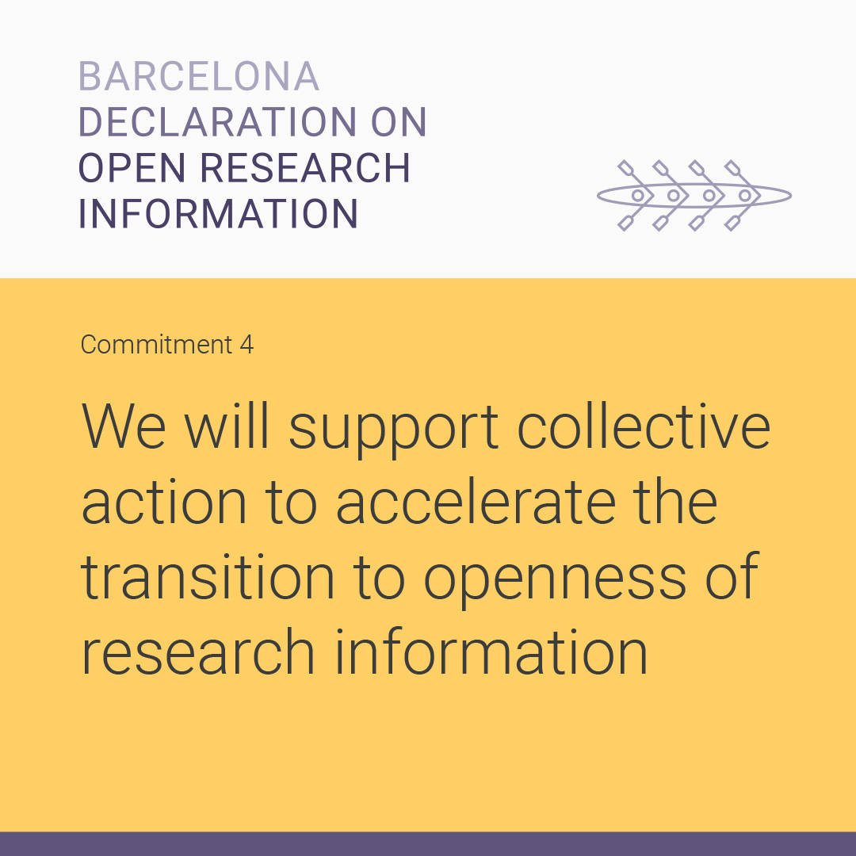
Perspectives on open research information
https://barcelona-declaration.org

Slide 26
Perspectives on open infrastructures
[advocacy points collectively developed by infrastructures]

Slide 27
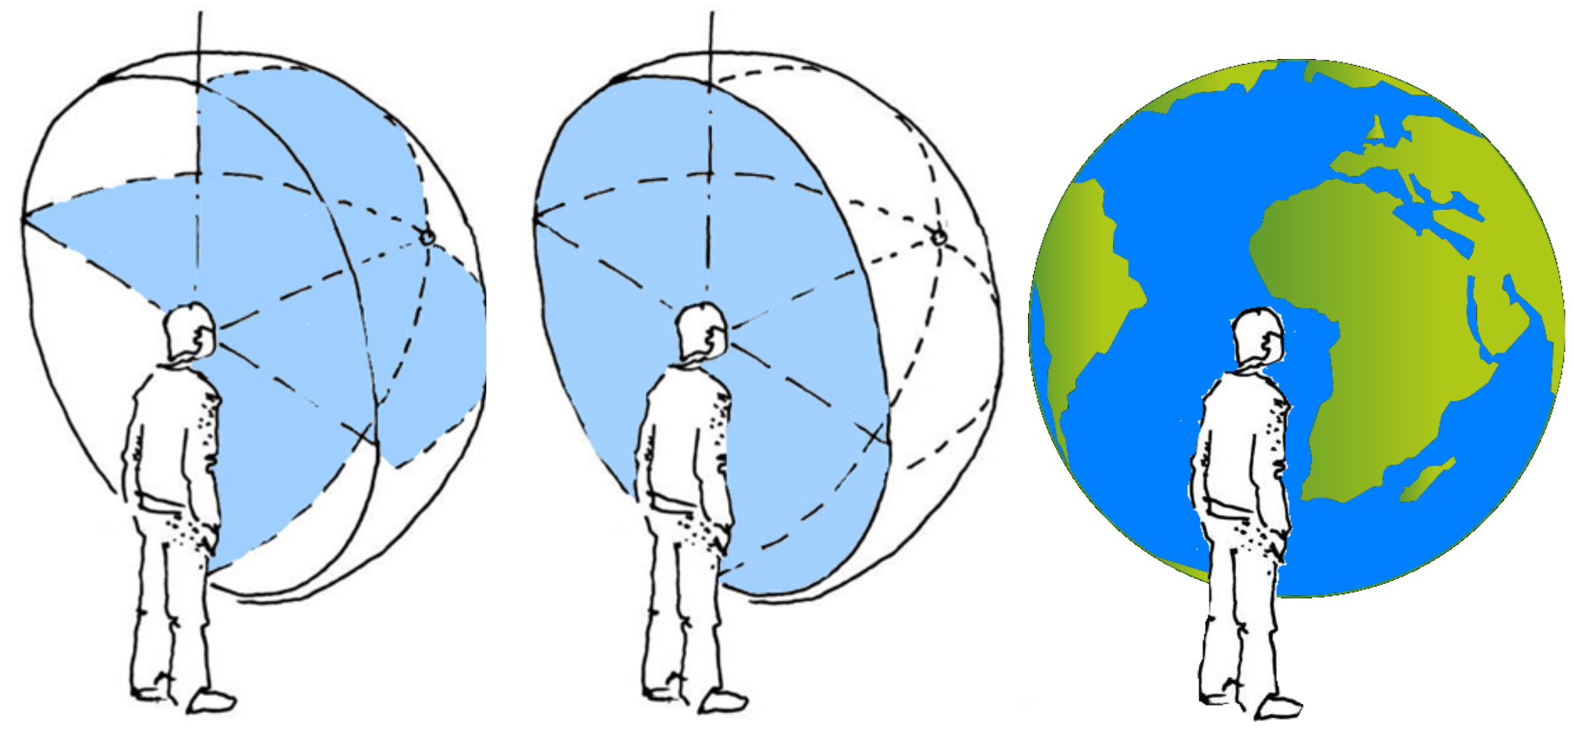
Directions to choose, decisions to make

Slide 28
Some background

Slide 29
Research assessment and openness
– a multi-faceted relationship
PUBMET2024
Bianca Kramer
@akademienl.social/@MsPhelps
Open science. Open metadata. Open infrastructure
https://tinyurl.com/pubmet-2024-kramer

