Slide 1
Digital library of the Belgrade City Library in the service of Citizen Science

Slide 2
Hronology of Digital BCL
AccessIT Project
dLibra Digital Library
Transition to ResCarta Platform

Slide 3
Use Cases
Historical Research
Journalism
Education

Slide 4
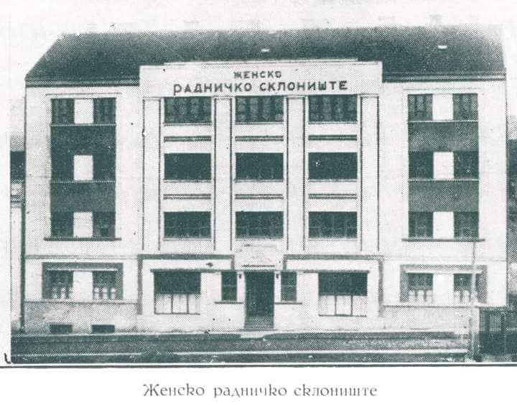
Jelena Jovanović Simić, Museum of the Serbian Medical Society Research topic: The first years of the Children’s Clinic in Belgrade

Slide 5
School Polyclinics in Belgrade in 1925. “Five Years of Social-Medical Work in the Kingdom of Serbs, Croats, and Slovenes ˝1920–1925” . Zagreb: Institute for Social Medicine of the Ministry of Public Health in Zagreb, 1925
Библиотека града Београда (bisis.rs)

Slide 6
Žaklina Nikolić, Library Center for Culture Kladovo Research topic: photo-documentary exhibition “Centuries of Fetislam 1524–2024

Slide 7
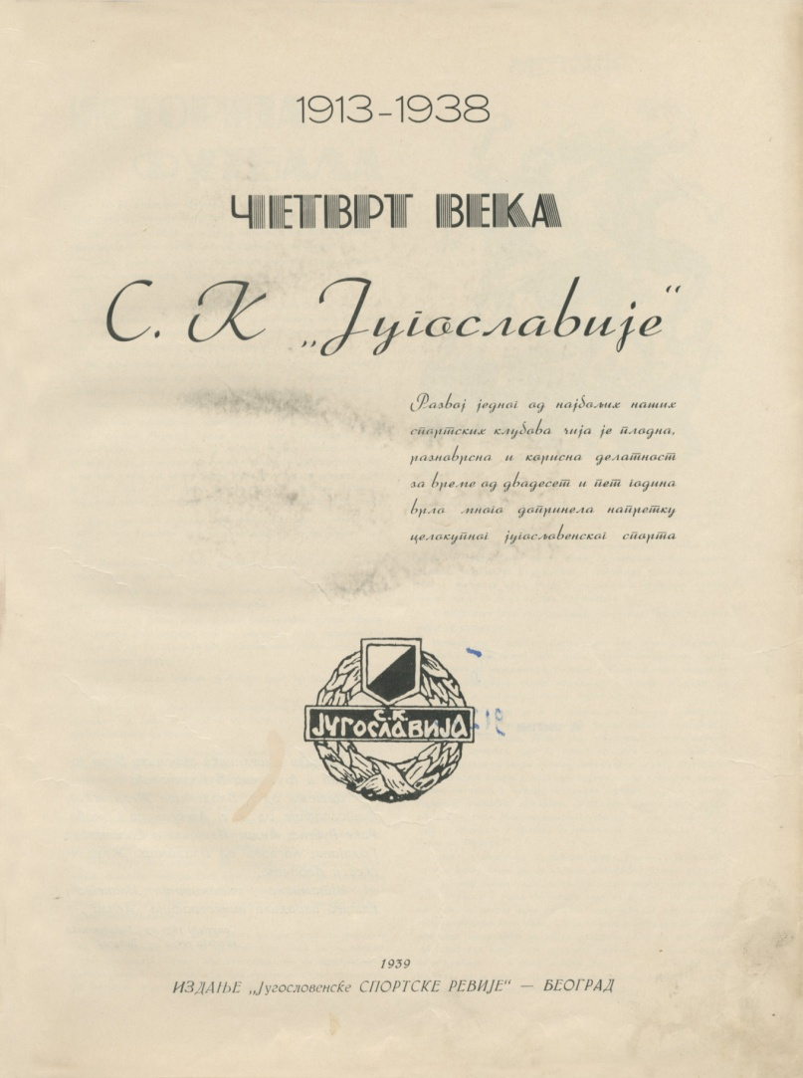
Olivera Nedeljković, City Library “Vladislav Petković Dis” from Čačak Research topic: Photographs and biographies of children’s writers, portrait of Andra Franićević

Slide 8
Thank you for your attention!
Olivera Nastić
Belgrade City Library
olivera.nastic@gmail.com

