Slide 1
Acting virtuously as an editor: practical wisdom
PUBMET Summer School, Zadar
Matt Hodgkinson,
10 September 2024

Slide 2
Research integrity principles
UK Concordat to Support Research Integrity and ALLEA’s European Code of Conduct
Transparency: My COIs
COPE Council member 2020-
EASE Treasurer 2021-25
Hindawi 2016-22
UKRIO 2022-24
VIRT2UE Train-the-Trainer participant 2024
Freelance consultant 2024:
MyRA.org
Training: AIPP, RSC
RI work: Sage, SNG
Reliability & Rigour
Honesty, Transparency, & Open Communication
Care & Respect
Accountability
allea.org/code-of-conduct
universitiesuk.ac.uk/topics/research-and-innovation/concordat-support-research-integrity

Slide 3
ALLEA’s European Code of Conduct
Some relevant items
Promptly issue corrections or retract publications, if necessary, the retraction processes are clear and the reasons stated, and authors are given credit for issuing corrections post-publication.
Negative results can be as relevant as positive findings for publication and dissemination.
Assess submissions… in a transparent and justifiable manner, and disclose the use of AI and automated tools.
Declare any actual or perceived conflicts of interest and, when necessary, withdraw from involvement
Maintain confidentiality unless there is prior approval for disclosure.
Respect the rights of authors, and seek permission to make use of the ideas, data, or interpretations…
Adopt assessment practices based on principles of quality, knowledge advancement, and impact that go beyond quantitative indictors and take into account diversity, inclusiveness, openness, and collaboration where relevant.

Slide 4
ALLEA’s European Code of Conduct
Some relevant items
Misconduct includes:
Establishing, supporting, or deliberately using journals, publishers, events, or services that undermine the quality of research (‘predatory’ journals or conferences and paper mills).
Participating in cartels of reviewers and authors colluding to review each other’s publications.
Ignoring putative violations of research integrity by others or covering up inappropriate responses to misconduct or other violations by institutions.

Slide 5
Credit: Virt2ue ethics

Slide 6
Virtues, dilemmas, and norms
“We are what we repeatedly do. Excellence, then, is not an act but a habit.”
Will Durant, 1926
(not Aristotle) stoicquotes.com/we-are-what-we-repeatedly-do
A quick look at how to act ethically
Virtues in research integrity embassy.science/wiki/Theme:520b3bc7-a6ab-4617-95f2-89c9dee31c53
Moral conflict and dilemma embassy.science/wiki/Theme:17d406f9-0b0f-4325-aa2d-2fe186d5ff34
Values and norms embassy.science/wiki/Theme:B4f7b2e3-af61-4466-94dc-2504affab5a8
Dialogue and debate embassy.science/wiki/Theme:6217d06b-c907-4b09-af4e-b4c8a17b9847
From the Embassy of Good Science

Slide 7
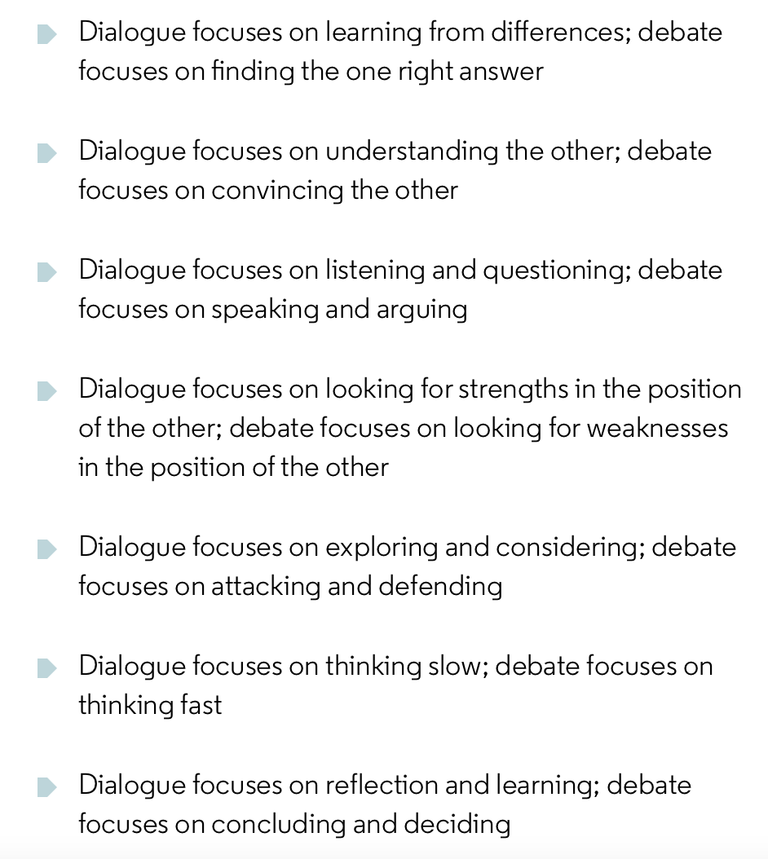
Dialogue versus Debate: Embassy of Good Science embassy.science/wiki/Theme:6217d06b-c907-4b09-af4e-b4c8a17b9847

Slide 8
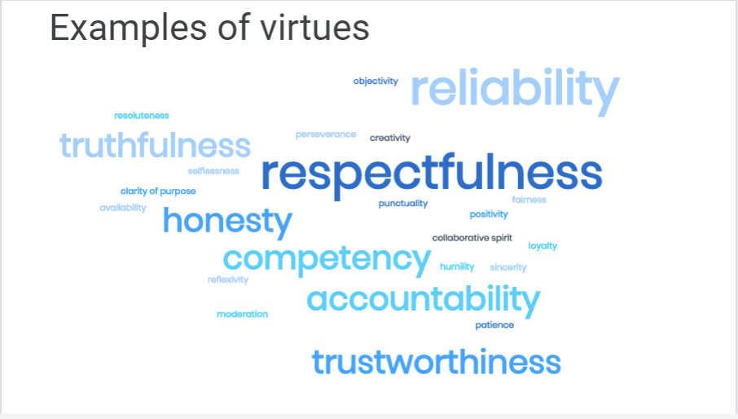
Credit: Virt2ue ethics

Slide 9
EDCI 702: Curriculum, Instruction, and Assessment Copyright © 2020 by Thomas Vontz and Lori Goodson is licensed under a Creative Commons Attribution-NonCommercial-ShareAlike 4.0 International License, except where otherwise noted.

Slide 10
The Middle Position
Can you have too much of a good thing?
Are you always honest (as an editor)?
Can you be too honest (as an editor)?
An example: transparency versus respect (including privacy). What are the vices (too much, too little), and what might be the middle position to reconcile these principles?

Slide 11
Your own editorial dilemma
For later
Dilemma - a choice of two actions where different moral principles collide
Think of a real-life editorial dilemma you faced
Why was it a dilemma?
What did you do, and why?
What else could you have done?
Will you be willing to share it, in confidence, with the group? (hopefully yes!)
Don’t share it yet!

Slide 12
Peer review
Be mindful of your approach
Select and vet your own reviewers:
Cover methodological/statistical expertise AND topic expertise
Diversity of institutions, countries, and scholarly standpoint
Don’t rely on author suggestions or automated suggestions
Reduce bias:
Double anonymisation pre-publication (see Fox, C. W., Meyer, J., & Aimé, E. (2023). Double-blind peer review affects reviewer ratings and editor decisions at an ecology journal. Functional Ecology, 37, 1144–1157. doi.org/10.1111/1365-2435.14259)
Declare and manage COIs
Open reports and/or identities post-publication (see Ross-Hellauer, T., Görögh, E. Guidelines for open peer review implementation. Res Integr Peer Rev 4, 4 (2019). doi.org/10.1186/s41073-019-0063-9)

Slide 13
Peer review: Dilemma game
Cultural difference? from https://dilemmagame.eur.nl/ui/
What would you do? Why?
What would you ideally do? Why?

Slide 14
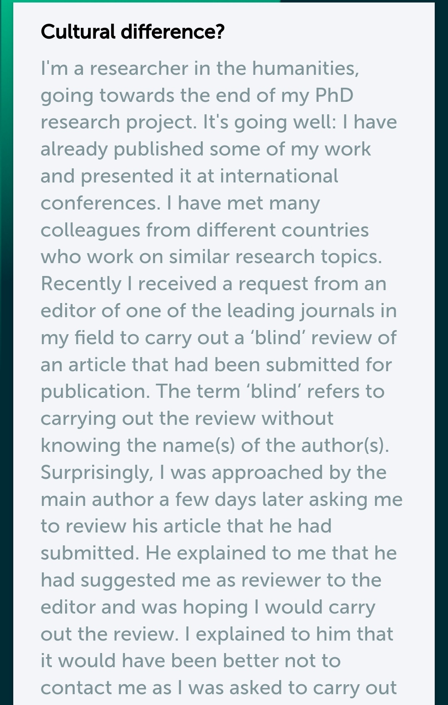
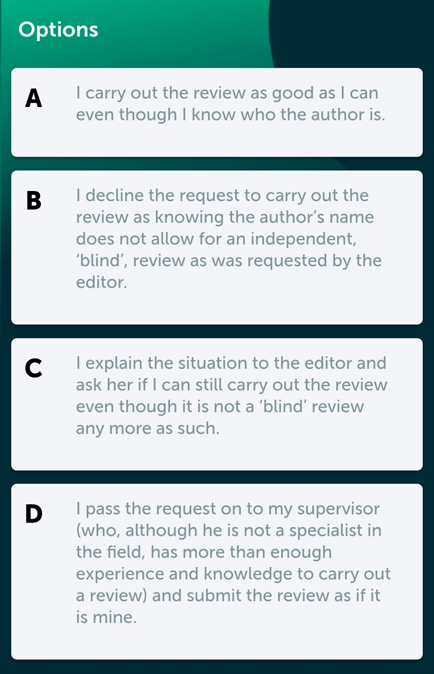
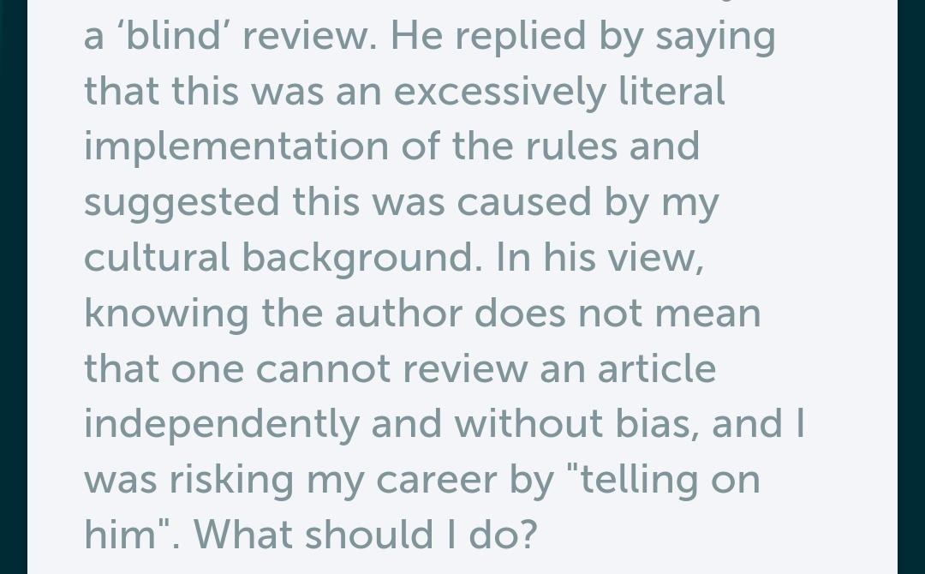

Slide 15
Decision making
Pull your weight as an editor
Take responsibility:
Don’t count votes or be a passive ‘umpire’
Read and critique the article yourself
Help authors understand conflicting reviews
Don’t give the benefit of the doubt on ethics/integrity. Otherwise, be supportive:
Don’t reject on a technicality
Don’t ask for more work unless essential for the conclusions
Only edit/redact if reviews are grossly offensive or unconstructive

Slide 16
Figures
Manipulation and duplication
Spotting duplication and manipulation:
Manually, à la Elisabeth Bik scienceintegritydigest.com
Automation: Proofig / ImageTwin / FigCheck / Imachek / Resis / etc.
stm-assoc.org/standards-technology/working-group-on-image-alterations-and-duplications/stm-image-alterations-duplications-resources/
Ask for the original unedited images (e.g., if overcropped, overexposed)
Duplication across articles:
Compare images in articles with high text similarity

Slide 17
Figures: Dilemma game
Original images, from https://dilemmagame.eur.nl/ui/
What would you do? Why?
What would you ideally do? Why?

Slide 18
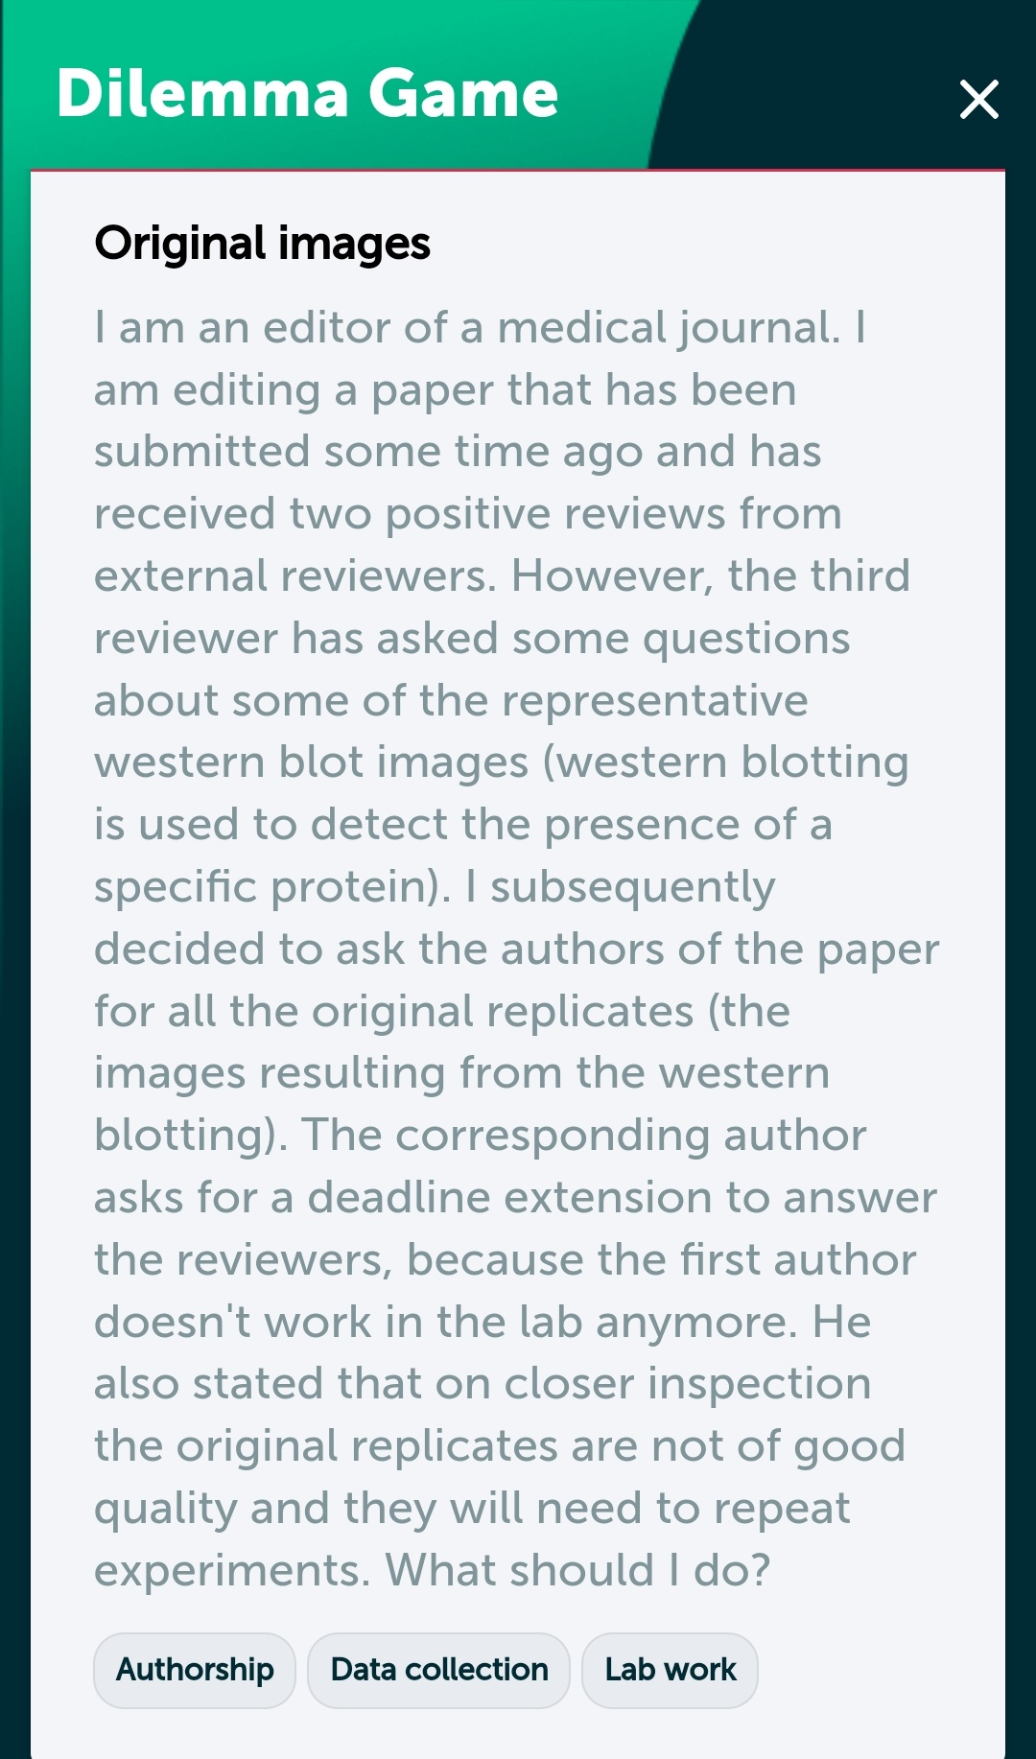
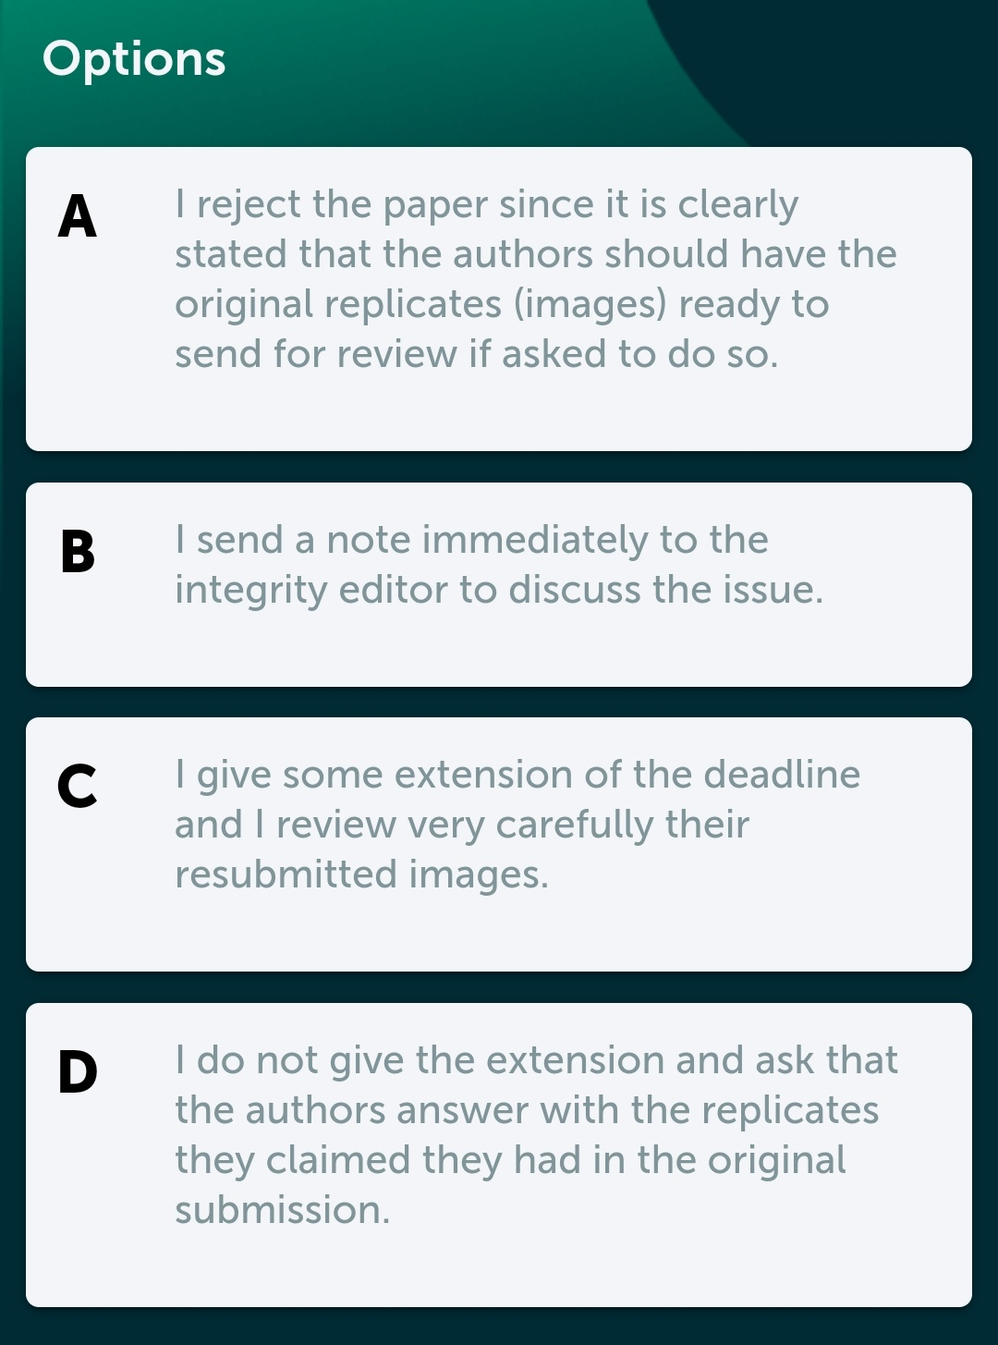

Slide 19
Reporting guidelines
Reproducibility!
Effect sizes and variability, e.g., 95% confidence intervals, not only p-values
Exact p-values, not p<0.05, etc.
Avoid spin: ban ‘marginal significance’, ‘nearing significance’, etc.
Endorse, mandate… or use?
Surgeons and pilots use checklists: so why not editors?
Essential in clinical medicine: equator-network.org
Common in biology: fairsharing.org
Less developed in other fields, but see FAIRsharing, e.g., physics
Nature Research’s reporting summary for life/social/environmental sciences: researchgate.net/figure/The-Nature-Research-Reporting-Summary-Checklist-available-under-a-Creative-Commons_fig2_337053051
Mandating reporting guidelines isn’t sufficient to improve reporting: Hair, K., Macleod, M.R., Sena, E. et al. A randomised controlled trial of an Intervention to Improve Compliance with the ARRIVE guidelines (IICARus). Res Integr Peer Rev 4, 12 (2019). doi.org/10.1186/s41073-019-0069-3

Slide 20
Data
Meta-data
Availability and analysis
Signals outside the article text
Availability during peer review
Data sharing post-publication
Digital forensic analysis:
Leading digits: Eckhartt, G.M., Ruxton, G.D. Investigating and preventing scientific misconduct using Benford’s Law. Res Integr Peer Rev 8, 1 (2023). doi.org/10.1186/s41073-022-00126-w
Are trailing non-significant digits uniform?
‘Data thugging’: GRIM, GRIMMER, SPRITE, etc. prepubmed.org/data_thugging
Affiliations
ORCID
Grant numbers
Ethics approval numbers
Resource identifiers
File properties
research-signals.com, ScholarOne’s UADT

Slide 21
Documentation
Don’t take their word for it
If in doubt, or even routinely, ask for:
Ethics documentation
Grant approval documents
Drafts of articles
Raw data
Original uncropped and unadjusted photos / images
Registration, e.g., clinical trials and systematic reviews
Study protocols
What’s the dilemma with requiring prospective trial registration?

Slide 22
Authorship
Responsibility and credit
ICMJE or McNutt et al., PNAS criteria
icmje.org or ncbi.nlm.nih.gov/pmc/articles/PMC5856527
Require ORCIDs (orcid.org) for at least one author (filled out? institutionally verified?) What’s the dilemma?
Verify email addresses for each author and/or require institutional emails. What’s the dilemma?
Authorship changes:
Allow or disallow and at what stage? What’s the dilemma?
Topic-department mismatches, unlikely collaborations

Slide 23
Authorship: Dilemma game
More than 1000 papers, from https://dilemmagame.eur.nl/ui/
What would you do? Why?
What would you ideally do? Why?

Slide 24
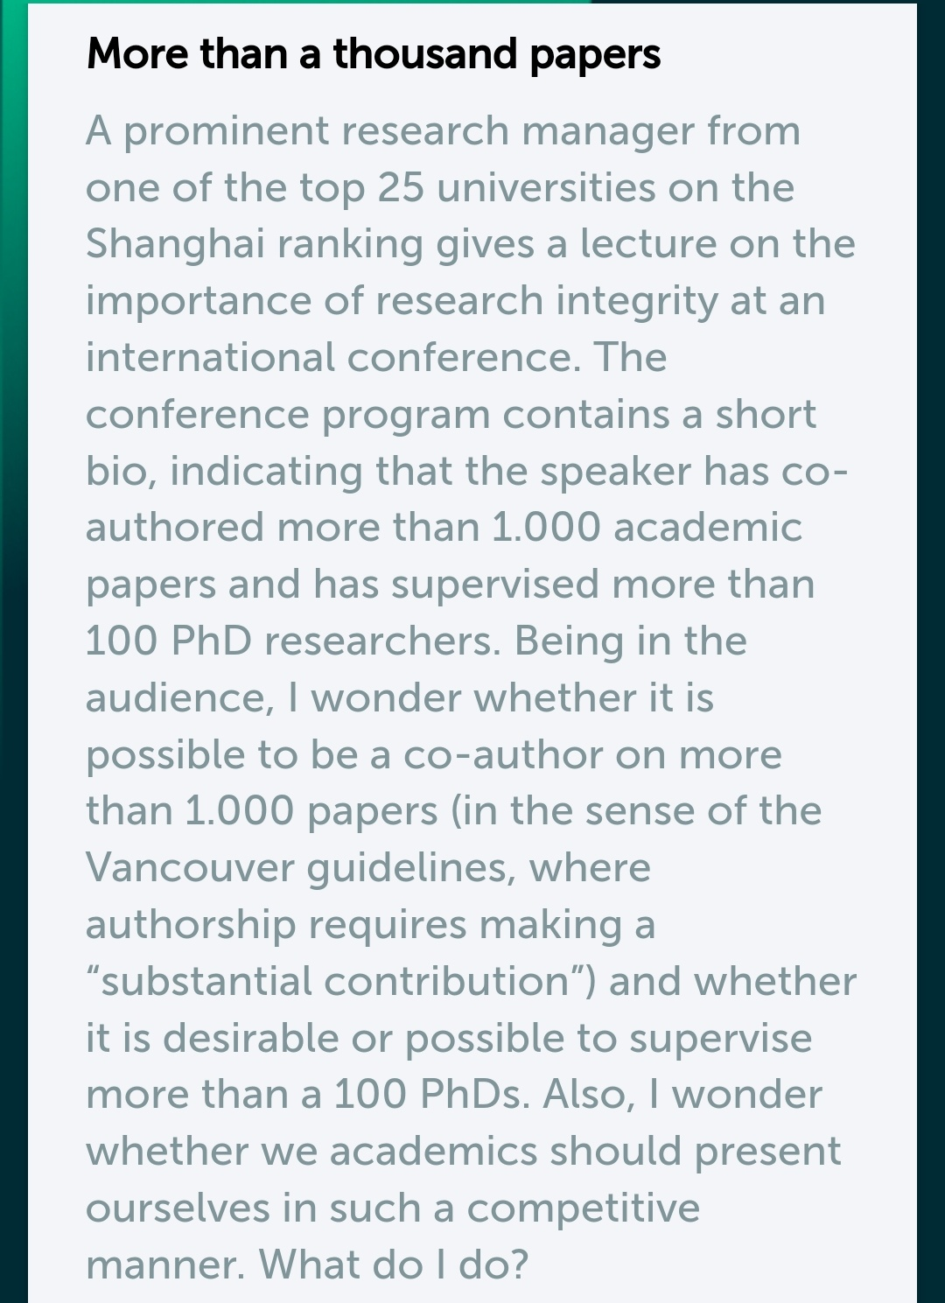
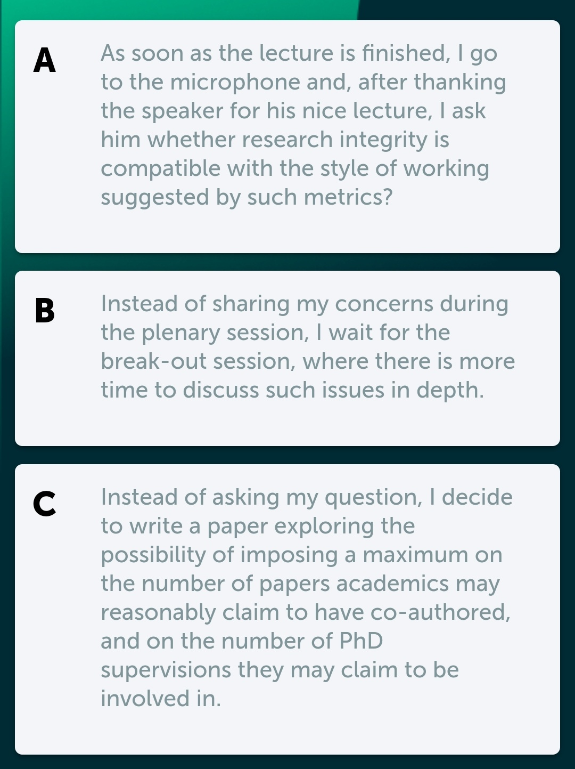
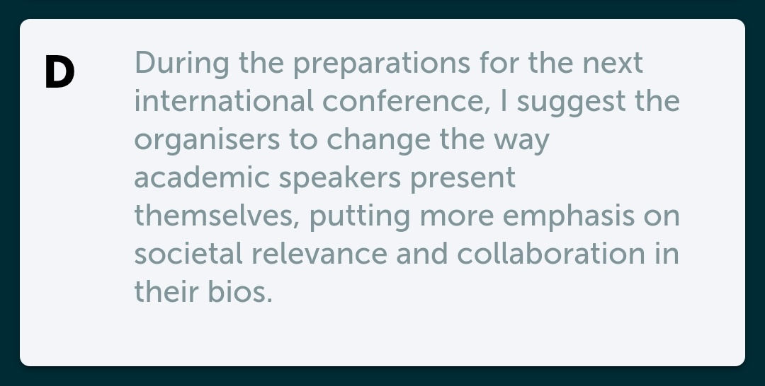

Slide 25
Handling suspected breaches
Misconduct and mistakes
Work with publisher research integrity teams
If you’re a member, seek advice from COPE forum and/or council publicationethics.org
Investigate, then decide:
No action / correction / expression of concern / retraction doi.org/10.24318/cope.2019.1.4
COPE’s practical guidance for bulk investigations: doi.org/10.24318/x0mN3xfd
Report to institutions:
All suspected serious misconduct, ASAP
ukrio.org/wp-content/uploads/Reporting-Research-Integrity-Concerns-180523.pdf

Slide 26
Tools for spotting known issues
Benefit from others’ hard work
PubPeer pubpeer.com
Problematic Paper Screener irit.fr/~Guillaume.Cabanac/problematic-paper-screener
Retraction Watch and the database
retractionwatch.com
retractiondatabase.org/RetractionSearch.aspx?
Now incorporated into Crossref, Zotero, Endnote, etc.

Slide 27
Obligatory mention of AI
Generative AI joins the party
AI (and other tools) can’t be authors
Generative AI shouldn’t be used by reviewers or editors
Watch for AI images: Midjourney’s are often cartoon-like, glowing, and include nonsense text
Detection of AI text is hard: often relies on low perplexity (perplexity = using unusual words) and low burstiness (burstiness = varying sentence length). Can be fooled easily and non-fluent speakers are often false positives.
HOT OFF THE PRESSES! Copyleaks is the best of a bad bunch:
Perkins, M., Roe, J., Vu, B.H. et al. Simple techniques to bypass GenAI text detectors: implications for inclusive education. Int J Educ Technol High Educ 21, 53 (2024). doi.org/10.1186/s41239-024-00487-w

Slide 28
Your editorial dilemma
Let’s pick one
Each quickly summarise a real-life dilemma you’re happy to share
Don’t say what you chose to do yet
You’ll vote on which to discuss
We’ll keep all details confidential

Slide 29
Your editorial dilemma
Present the case
Present your real-life dilemma
What were the two choices?
What were the moral questions?

Slide 30
Your editorial dilemma
Discuss the case
Clarify the case - ask question about details
Individually:
What are virtues relevant to the different choices?
Fill out a virtue and norms table: what are the relevant virtues, and what norms/action will those lead to?
Virtue | Norm/action
Justice | Credit all contributors
Courage | Speak out

Slide 31
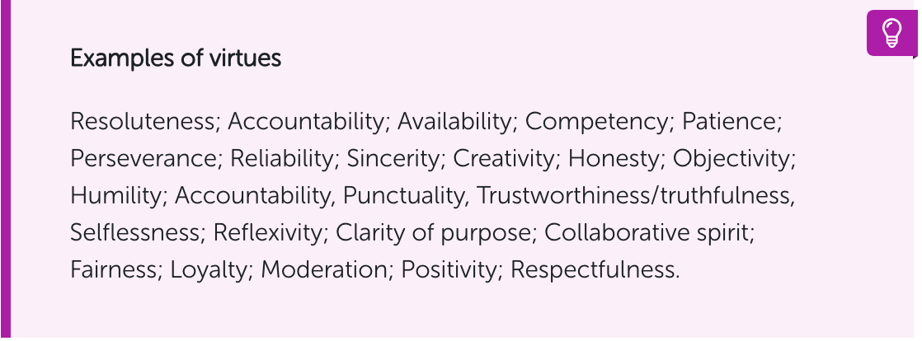

Slide 32
Your editorial dilemma
Dialogue (not debate)
What stands out?
Are there similarities/differences between perspectives? Do they conflict?
Do the virtues appear in the European Code for Research Integrity?
Most important virtue here? Why?
What is needed to concretely act on this virtue? Are there constraints?

