Slide 1
Improve your visibility and outreach with DIAMAS tools for Diamond OA publishers
Iryna Kuchma & Milica Ševkušić, EIFL
PUBMET SUMMER SCHOOL
Challenges of publications indexing, visibility, metadata and persistent identifiers, and interoperability of data
Zadar, Croatia, 12 September 2024

Slide 3
Aim
Answer the question ‘How to make a journal more visible with the help of tools developed by the DIAMAS project’?

Slide 4
Agenda
Introduction: DIAMAS project and a comprehensive approach to publishing quality
Developing DOAS
DOAS self-assessment tool: demonstration
Hands-on: How can DOAS help you improve visibility?
Wrap-up

Slide 5
Developing Institutional Open Access Publishing Models to Advance Scholarly Communication – DIAMAS
The DIAMAS project focuses on institutional publishers and service providers that do not charge fees to authors or readers. These ‘no fee’ publishing models are collectively known as Diamond Open Access.

Slide 6
DIAMAS Project
https://diamasproject.eu/
Project objectives
Provide the research community with an aligned, high-quality, and sustainable OA scholarly communication ecosystem, capable of implementing OA as a standard publication practice across the ERA.
Create a community, supporting services, and non-technical infrastructure for Institutional Publishing Service Providers (IPSPs) that adopt common standards, guidelines, and best practices.
Common standards, guidelines, and best practices
Duration: 36 months
Starting date: September 2022
Horizon Europe funding
Budget €3m
Participants: 23 public service scholarly organizations from 12 European countries

Slide 7
Defining the scope of quality
Seven core components (based on the Action plan for Diamond OA, but revised)
Funding
Legal Ownership, Mission, and Governance
Open Science
Editorial Management, Editorial Quality, and Research Integrity
Technical Service Efficiency
Visibility, Communication, Marketing, and Impact
Equity, Diversity, Inclusion, and Belonging (EDIB), Multilingualism, and Gender Equity

Slide 8
Analysis of existing quality evaluation criteria, best practices, and assessment systems in publishing
More than 70 documents were identified by the project team;
59 were analyzed in detail (dataset is available: https://doi.org/10.5281/zenodo.7859247)
The DIAMAS Best Practices report was published: (https://zenodo.org/doi/10.5281/zenodo.7859171)
The Best Practices Checklist for Diamond OA Publishers was created:
https://diamasproject.eu/best-practices-checklist-for-diamond-oa-publishers/

Slide 9
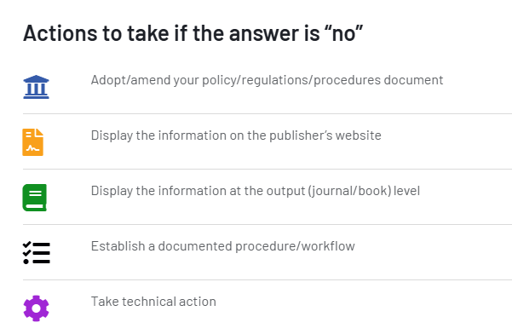
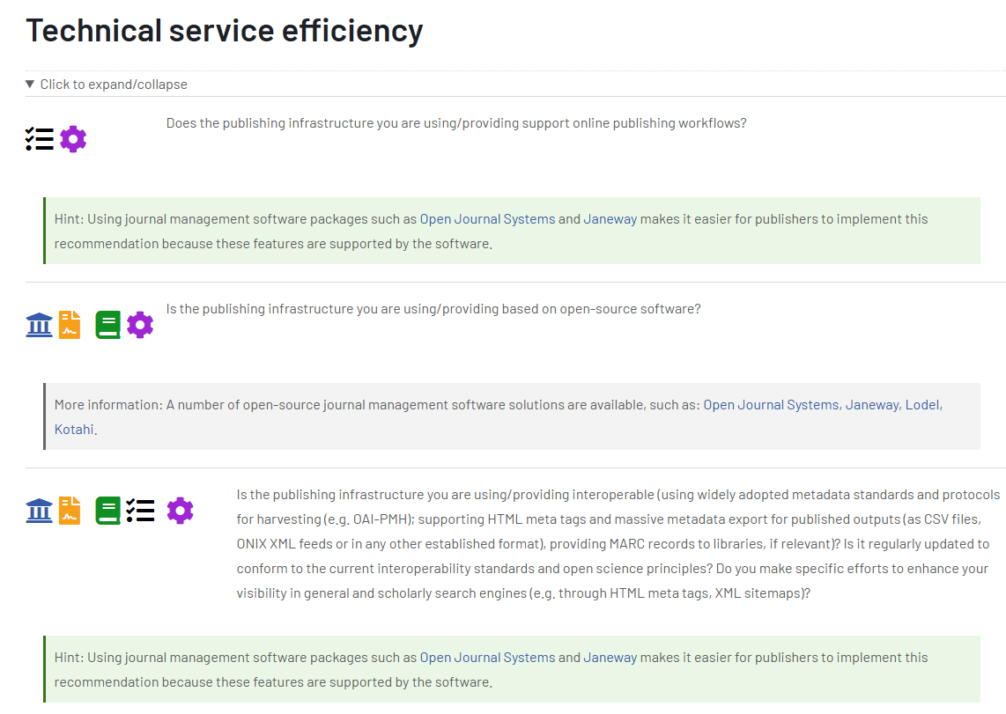
https://diamasproject.eu/best-practices-checklist-for-diamond-oa-publishers/

Slide 10
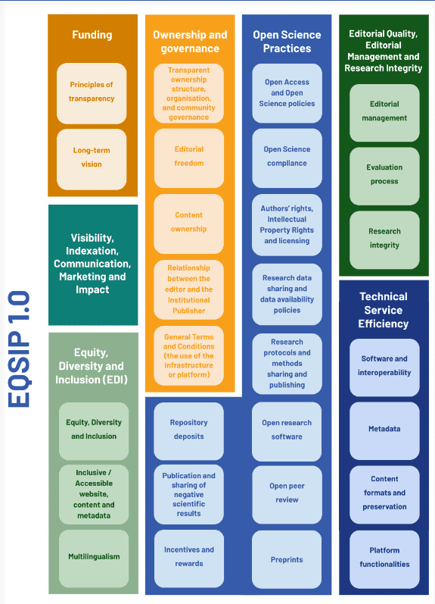
The DIAMAS Best Practices report was used as a starting point for developing the first version of the Extensible Quality Standard for Institutional Publishing (EQSIP).
After open consultations, a new version was developed…
https://doi.org/10.5281/zenodo.10406062

Slide 11
DOAS is based on criteria across seven key components of scholarly publishing:
Funding
Legal Ownership, Mission, and Governance
Open Science
Editorial Management, Editorial Quality, and Research Integrity
Technical Service Efficiency
Visibility, Communication, Marketing, and Impact
Equity, Diversity, Inclusion, and Belonging (EDIB), Multilingualism, and Gender Equity
Integrity and Standards: Protects the integrity of scholarly publishing by adhering to evidence-based standards developed with community consultation.
Support for Diamond OA publishing: Ensures high standards and supports the growth of Diamond OA publishing.
Transparency: Maintains transparency in governance, processes, and workflows, essential for credible and ethical publishing activities.
https://doi.org/10.5281/zenodo.12179620

Slide 12
Diamond OA Standard (DOAS)
Funding
Open Science
Technical Service Efficiency
Visibility, Communication, Marketing and Impact
Diamond OA business model
Open policies
Presence
Publishing infrastructure
Sustainability
Authors’ rights, Intellectual Property Rights and licensing
Communication
Interoperability and metadata
Editorial independence
Analysis
Repositories
Collaboration
Legal, Ownership, Mission
and Governance
EDIB, Gender and Multilingualism
Ownership
Editorial Management, Editorial Quality and Research Integrity
EDIB and Gender
Governance
Accessibility
Editorial bodies
Editorial quality
Relations with service providers
Peer review
Research integrity
Multilingualism

Slide 13
Funding
Core component and Heading | Item | Level |  | Important for visibility
 |  | REQUIRED | DESIRED
1.1. Diamond OA business model | No paywalls | ✅
 | Transparency on paywalls | ✅
1.2. Sustainability | Financial support | ✅
 | Costs |  | ✅
 | Sustainability plan |  | ✅
 | Transparency on funding |  | ✅
1.3. Editorial Independence | Editorial operations | ✅
 | Revenue streams |  | ✅

Slide 14
Legal Ownership, Mission and Governance
Core component and Heading | Item | Level
 |  | REQUIRED | DESIRED
2.1. Ownership | Scholarly community | ✅
 | Ownership statement | ✅
 | Changes in ownership | ✅
 | Transparency in ownership | ✅
2.2. Governance | Mission | ✅
 | Scholarly community driven |  | ✅
 | Selection procedure | ✅
 | Co-publishing | ✅
 | Roles and responsibilities | ✅
 | Transparency in editorial board selection |  | ✅
2.3. Relations with Service Providers (SPs) | Agreement between IP and SPs |  | ✅
 | Agreement between IP journals and SPs |  | ✅

Slide 15
Open Science
Core component and Heading | Item | Level
 |  | REQUIRED | DESIRED
3.1. Open policies | Open Science policy |  | ✅
 | Open Access | ✅
 | Facilitating compliance with OA mandates | ✅
 | Underlying research data | ✅
 | Data policy content |  | ✅
 | Research protocols and methods |  | ✅
 | Open research software |  | ✅
 | Publication and sharing of negative scientific results |  | ✅
3.2. Authors’ Rights, Intellectual Property Rights, and Licensing | Rights retention policy | ✅
 | Open Licence | ✅
 | Third-party copyright |  | ✅
 | User’s rights |  | ✅
 | Transparency on rights retention publication policy | ✅
3.3. Repositories | Deposits of published articles | ✅
 | Acceptance of preprints |  | ✅

Slide 16
Editorial Management, Editorial Quality and Research Integrity
Core component and heading | Item | Level
 |  | REQUIRED | DESIRED
4.1. Editorial Bodies | Editorial independence | ✅
 | Editorial bodies transparency | ✅
 | Communication procedures between journals and IP | ✅
 | Skills/training |  | ✅
 | Engaging stakeholders |  | ✅
4.2. Peer Review | Peer Review | ✅
 | Peer-review policy and procedures | ✅
 | Lack of endogeny | ✅
 | Open peer review |  | ✅
 | Other contributors’ copyright |  | ✅
 | Acknowledgement of reviewers |  | ✅
 | Incentives and rewards |  | ✅
4.3. Editorial Quality | Guidelines for author(s) | ✅
 | Guidelines for reviewers | ✅
 | Manual of style | ✅
 | Suitable layout | ✅
 | Proofreading correction | ✅
 | Languages of submission | ✅
 | Publishing timelines | ✅
4.4. Research Integrity | Guidelines for authorship and/or contributorship |  | ✅
 | Research and publication ethics | ✅
 | Conflict of interest | ✅
 | Misconduct policy | ✅
 | Guidelines for Artificial Intelligence |  | ✅

Slide 17
Technical Service Efficiency
Core component and Heading | Item | Level
 |  | REQUIRED | DESIRED
5.1. Publishing Infrastructure | Use of platform | ✅
 | Documentation |  | ✅
 | Security | ✅
 | Basic functionalities | ✅
 | Advanced functionalities |  | ✅
 | Basic infrastructure management | ✅
 | Advanced infrastructure management |  | ✅
 | Long term preservation | ✅
5.2. Interoperability and Metadata | Interoperability protocols |  | ✅
 | Core metadata | ✅
 | Complete metadata | ✅
 | Persistent identifiers | ✅
 | Registration of persistent identifiers | ✅
 | Text and data mining |  | ✅
 | Formats |  | ✅
 | Citations | ✅
 | Personal Data Protection |  | ✅
5.3. Collaboration | Open source |  | ✅
 | Return to the community |  | ✅

Slide 18
Visibility, Communication, Marketing, and Impact
Core component and heading | Item | Level
 |  | REQUIRED | DESIRED
6.1. Presence | Visibility | ✅
 | Discoverability | ✅
6.2. Communication | Communication channels |  | ✅
 | Community management |  | ✅
 | Marketing |  | ✅
 | Visual identity |  | ✅
6.3. Analysis | Metrics |  | ✅
 | Analytical tools |  | ✅

Slide 19
EDIB, Gender and Multilingualism
Core component and heading | Item | Level
 |  | REQUIRED | DESIRED
7.1. EDIB and Gender | EDIB policy at the IP level |  | ✅
 | EDIB monitoring |  | ✅
 | Equity in submissions and decisions | ✅
 | Bias-free language | ✅
 | Research data sensitiveness | ✅
7.2. Accessibility | Accessible website | ✅
 | Monitoring |  | ✅
7.3. Multilingualism | Abstracts |  | ✅
 | Plain language summary |  | ✅
 | Full text | ✅
 | Website and content | ✅
 | Translation |  | ✅
 | Language technologies | ✅
 | Metadata translation |  | ✅

Slide 20
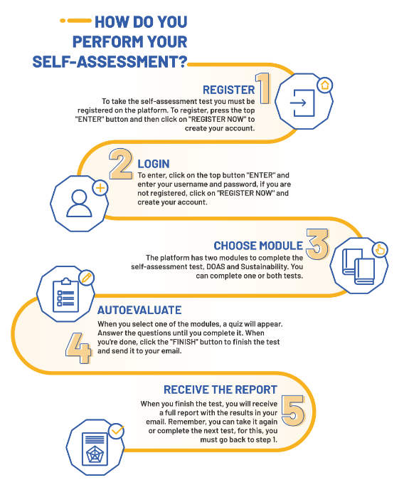
Self-assessment tool
A web-based application for institutional publishers (IPs) and service providers (SPs) enabling them to analyze their level of compliance with the DOAS and sustainability guidelines.
Currently only the DOAS self-assessment module is available.
https://diamas.fecyt.es/

Slide 21
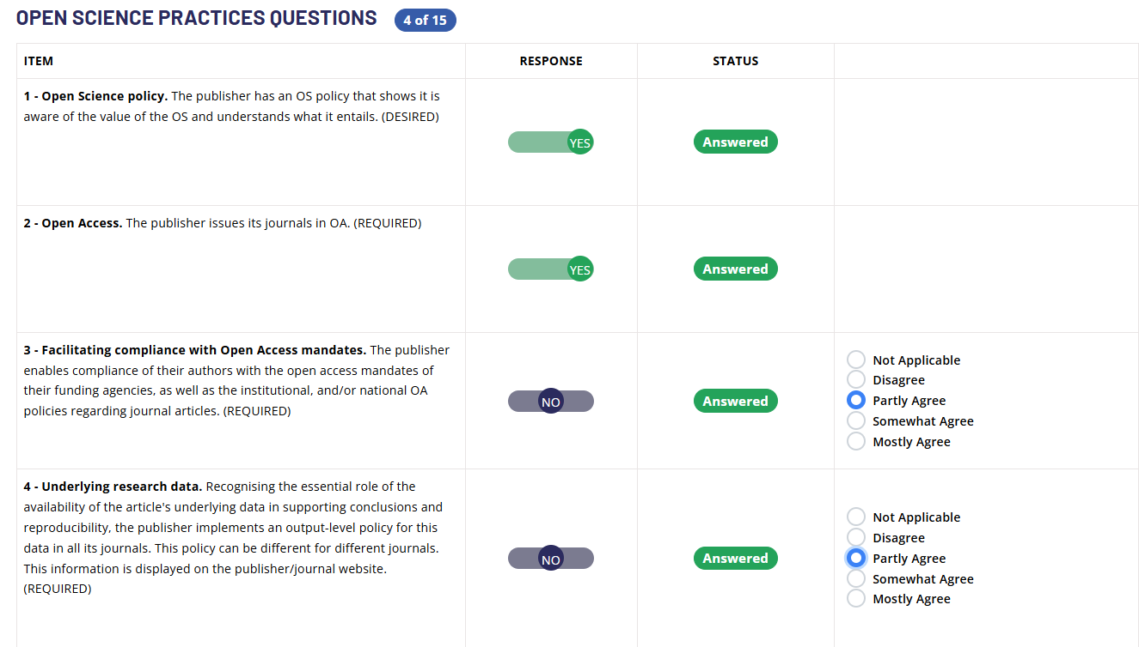

Slide 22
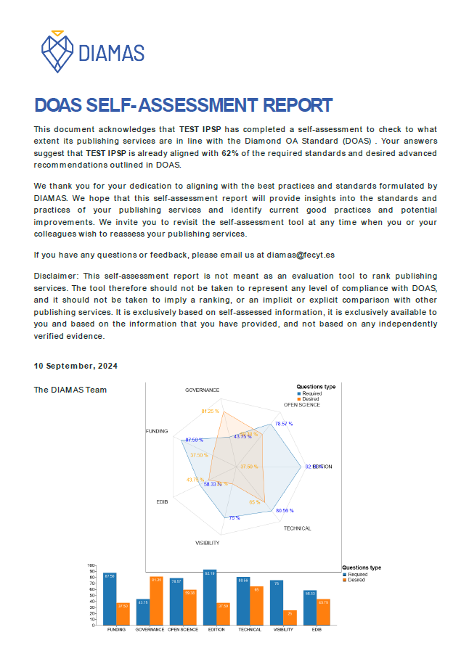
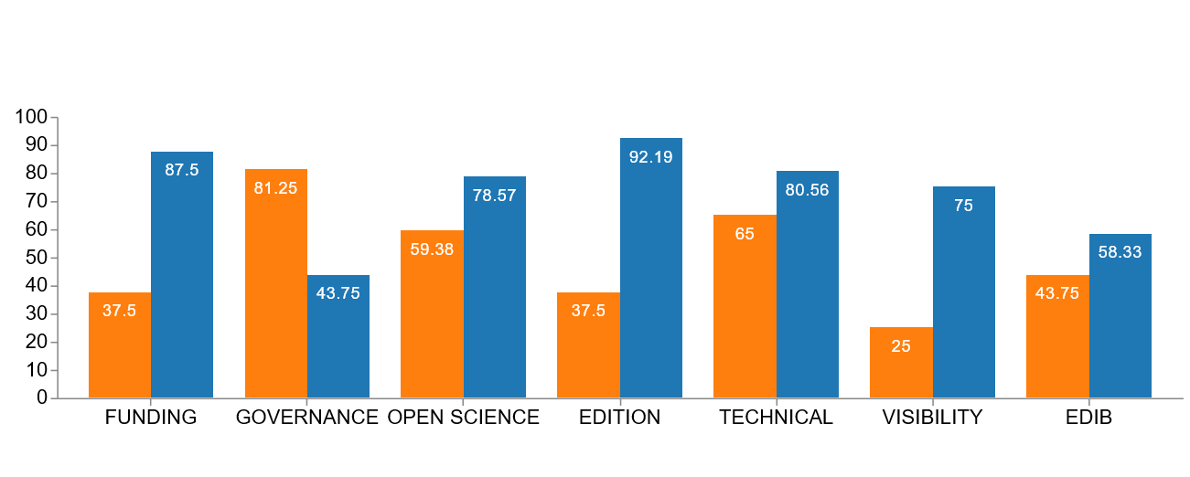
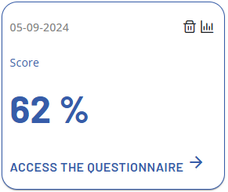
Results
One-page report (PDF)
Online report

Slide 23
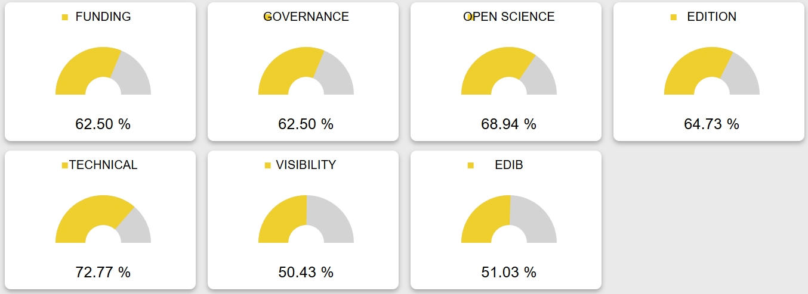
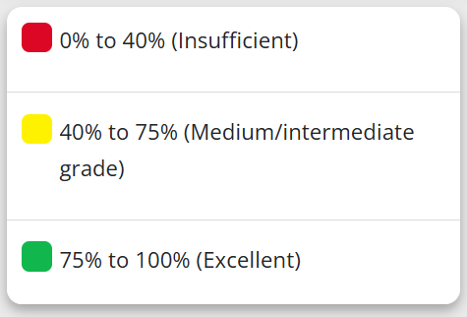

Slide 24
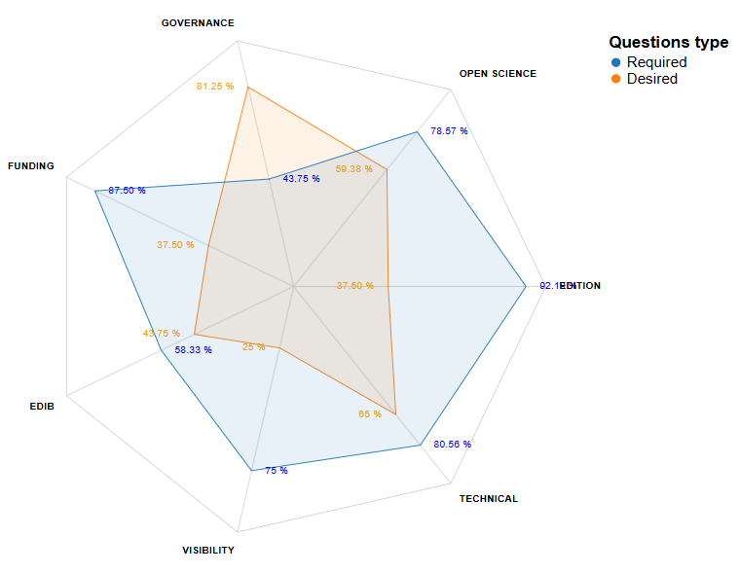

Slide 25
DOAS can help you identify what needs to be improved in order to ensure better visibility of your journal and its chances to get indexed.

Slide 26
Scan the QR code
Mark all elements that you consider relevant for visibility.
Let’s discuss!

Slide 27
Thank you!
Questions?
Newsletter subscription: DIAMAS
Follow us: @diamasproject
Have a closer look: diamasproject.eu

