Slide 1
DIAMAS tools and resources for Diamond OA publishing
PUBMET2024
Iryna Kuchma & Milica Ševkušić, EIFL
Zadar, Croatia, 12 September 2024

Slide 2
Overview
DIAMAS project
The results of DIAMAS
Research
Tools and best practice
Policy recommendations
Diamond OA and research assessment

Slide 3
Developing Institutional Open Access Publishing Models to Advance Scholarly Communication – DIAMAS
The DIAMAS project focuses on institutional publishers and service providers that do not charge fees to authors or readers. These ‘no fee’ publishing models are collectively known as Diamond Open Access.

Slide 4
DIAMAS Project
https://diamasproject.eu/
Project objectives
Provide the research community with an aligned, high-quality, and sustainable OA scholarly communication ecosystem, capable of implementing OA as a standard publication practice across the ERA.
Create a community, supporting services, and non-technical infrastructure for Institutional Publishing Service Providers (IPSPs) that adopt common standards, guidelines, and best practices.
Common standards, guidelines, and best practices
Duration: 36 months
Starting date: September 2022
Horizon Europe funding
Budget €3m
Participants: 23 public service scholarly organizations from 12 European countries

Slide 5
Diamond Open Access publishing
Provides equitable publication venues
Supports scholarly communication in native languages
Fosters multilingualism and bibliodiversity
Challenges
Fragmentation
Limited visibility
Insufficient recognition in local and international research assessment systems
Fluctuating income streams
Reliance on volunteer work

Slide 6
Research

Slide 7
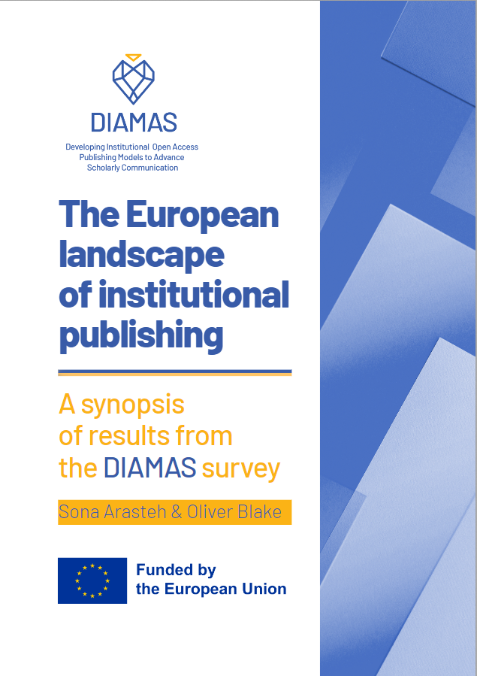
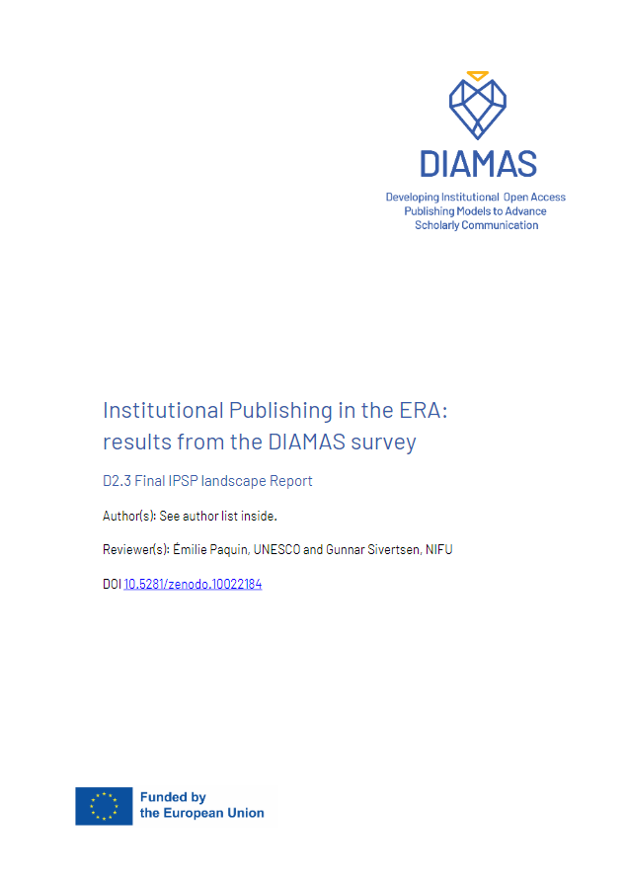
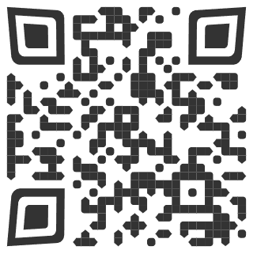
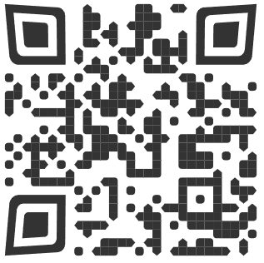
Landscape of Diamond OA publishing in Europe
Landscape of Diamond OA publishing in Europe
Arasteh, S., & Blake, O. (2024). The European landscape of institutional publishing - A synopsis of results from the DIAMAS survey. Zenodo. https://doi.org/10.5281/zenodo.10551710
Full report: Institutional Publishing in the ERA: Results from the DIAMAS survey. 2023. Zenodo. https://doi.org/10.5281/zenodo.10022184

Slide 8
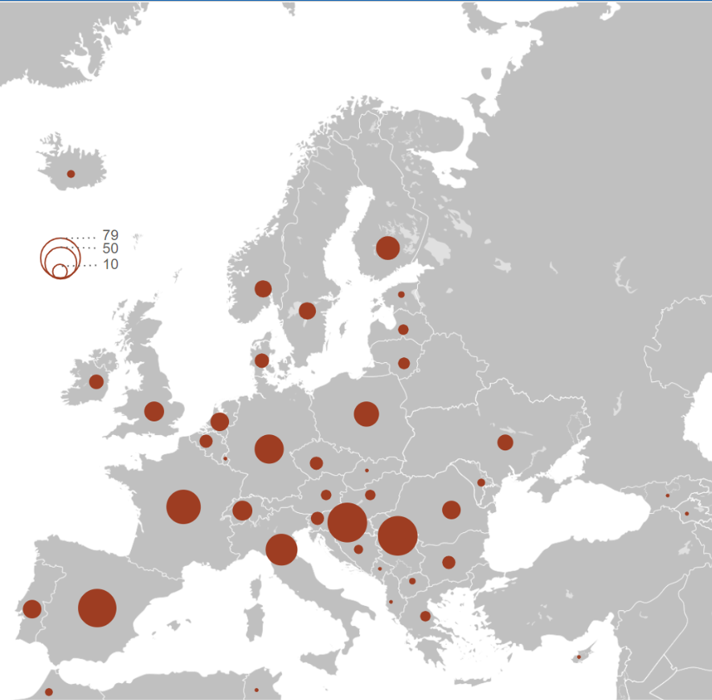
Who are institutional publishers?
85% are non-commercial or not-for-profit (private or public)
What do they publish?
90% publish journals and the majority also publish other outputs (books, conference outputs, etc.)
How open are their publications?
90% of journal articles, 76% of conference outputs and 58% of books are Open Access (OA).
How do they sustain their publishing operations?
Various income streams and small budgets (49% operate on <50K EUR)
Non-monetary and in-kind support from their parent organisations
How do they provide the publishing infrastructure?
Reliance on parent organisations and collaboration with various service providers
More than 70% use publishing platforms based on open-source software.
What challenges do they face?
Financial challenges
Efforts to improve quality
Archiving and digital preservation.
Indexation in international databases.
Equity, Diversity, Inclusion and Belonging (EDIB) dimensions are not yet an accepted standard in scholarly publishing.

Slide 9
Financial sustainability of institutional publishers and service providers in Europe
Sustainability
The capacity to develop and implement feasible medium-term resource strategies that facilitate the consistent execution of editorial tasks, incorporating essential developmental elements for adhering to globally recognised quality standards in editorial work and publishing, all while guaranteeing the continuous accessibility of published content. This capacity can depend on the internal resources and expectations of institutional publishers and service providers, the contextually available funding and workforce sources, and the effectiveness of the strategies deployed.

Slide 10
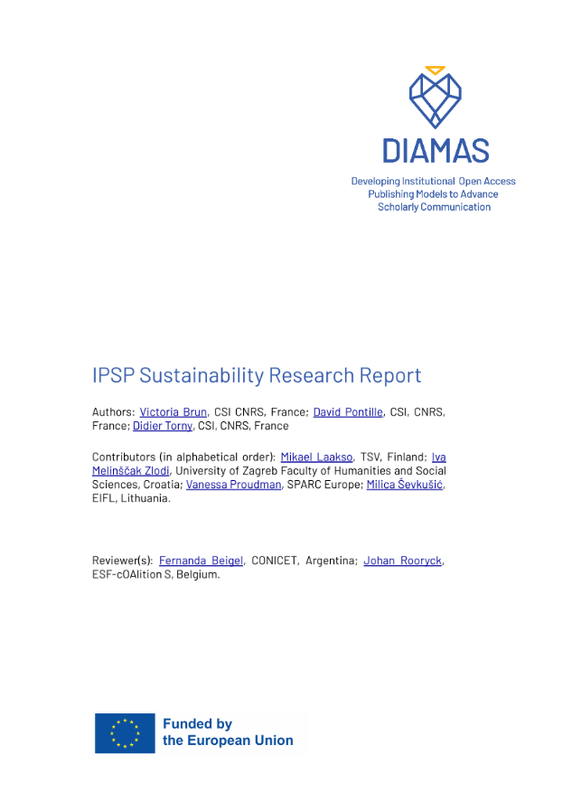
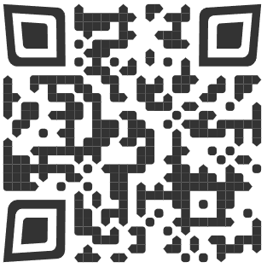
Great diversity in terms of mission, size and services
Different funding streams
Reliance on parent organisations and public national or regional funders
Need for more stable and long-term funding that entails less administration.
Personnel is more central to sustainability than monetary resources.
By funding infrastructures we support many small- to medium-size IPSPs that use them.
Brun, V., Pontille, D., & Torny, D. (2024). D5.1 IPSP Sustainability Research Report (1.0). o. https://doi.org/10.5281/zenodo.10907086
IPSPs have a clear view of challenges and need stronger support from public funders and research organizations. They share a vision of a Diamond OA funding landscape where the author-pays model is not a solution for the future.

Slide 11
Recommendations to help Diamond OA publishers and service providers become more sustainable
Coming soon:
Diamond OA Sustainability Check
Sustainability resources
It is vital that universities, libraries, research and other public institutions continue to support Diamond OA publishing.
Provide permanent and long-term funding for Diamond OA publishing initiatives.
Support strategic investment and innovation in the Diamond OA sector by funding both operational and development costs.
Support local, regional, national and international infrastructures and services used by many.
By contributing to the funding of Diamond OA you support Open Access, Equity, Diversity, Inclusion and Belonging and the Sustainable Development Goals.
Make international funding available to those who have no support from their local environment or national policies
Relieve administrative burdens when providing time-limited grants.

Slide 12
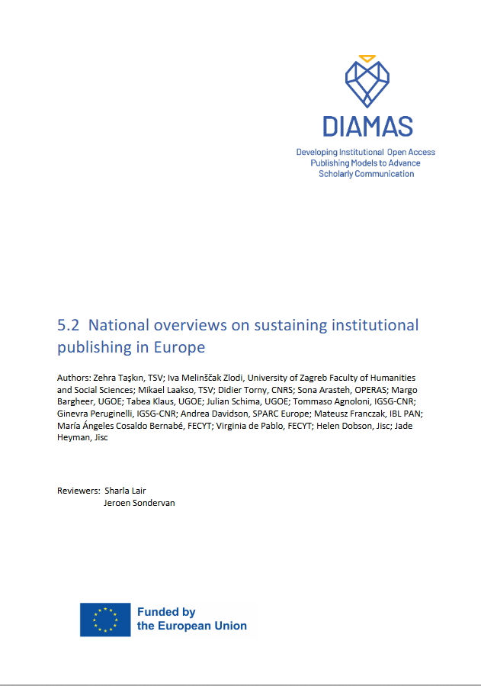
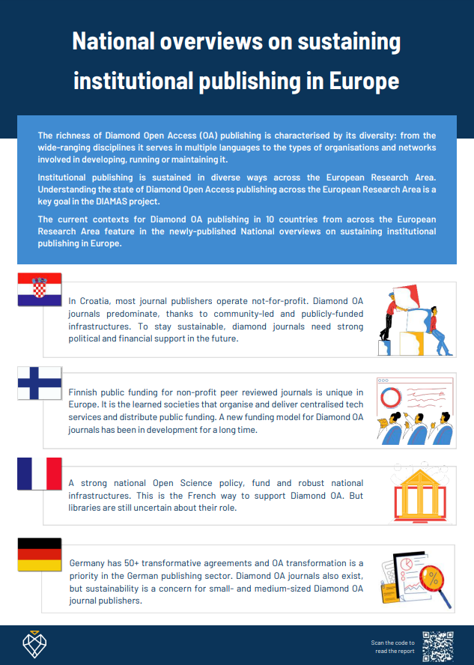
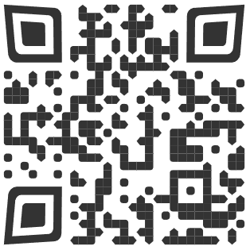
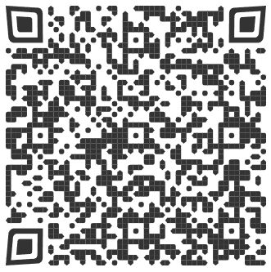
National overviews on sustaining institutional publishing in Europe
The report shows the current contexts for Diamond OA publishing in 10 countries:
Croatia
Finland
France
Germany
Italy
The Netherlands
Norway
Poland
Spain
United Kingdom
D5.2 National overviews on sustaining institutional publishing in Europe. Zenodo. https://doi.org/10.5281/zenodo.13683953
Factsheet

Slide 13
Standards and best practice

Slide 14
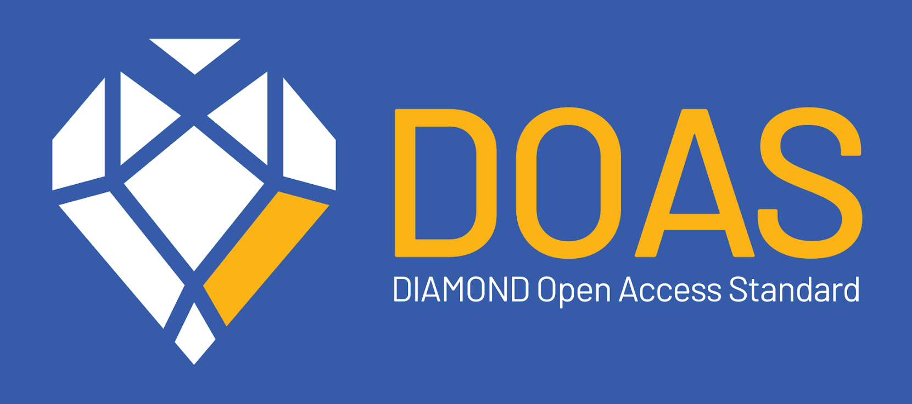
DOAS is based on criteria across seven key components of scholarly publishing:
Funding
Legal Ownership, Mission, and Governance
Open Science
Editorial Management, Editorial Quality, and Research Integrity
Technical Service Efficiency
Visibility, Communication, Marketing, and Impact
Equity, Diversity, Inclusion, and Belonging (EDIB), Multilingualism, and Gender Equity
Integrity and Standards: Protects the integrity of scholarly publishing by adhering to evidence-based standards developed with community consultation.
Support for Diamond OA publishing: Ensures high standards and supports the growth of Diamond OA publishing.
Transparency: Maintains transparency in governance, processes, and workflows, essential for credible and ethical publishing activities.
https://doi.org/10.5281/zenodo.12179620

Slide 15
DOAS: structure and topics
Funding
Open Science
Technical Service Efficiency
Visibility, Communication, Marketing and Impact
Diamond OA business model
Open policies
Presence
Publishing infrastructure
Sustainability
Authors’ rights, Intellectual Property Rights and licensing
Communication
Interoperability and metadata
Editorial independence
Analysis
Repositories
Collaboration
Legal, Ownership, Mission
and Governance
EDIB, Gender and Multilingualism
Ownership
Editorial Management, Editorial Quality and Research Integrity
EDIB and Gender
Governance
Accessibility
Editorial bodies
Editorial quality
Relations with service providers
Peer review
Research integrity
Multilingualism

Slide 16
Tools and guides

Slide 17
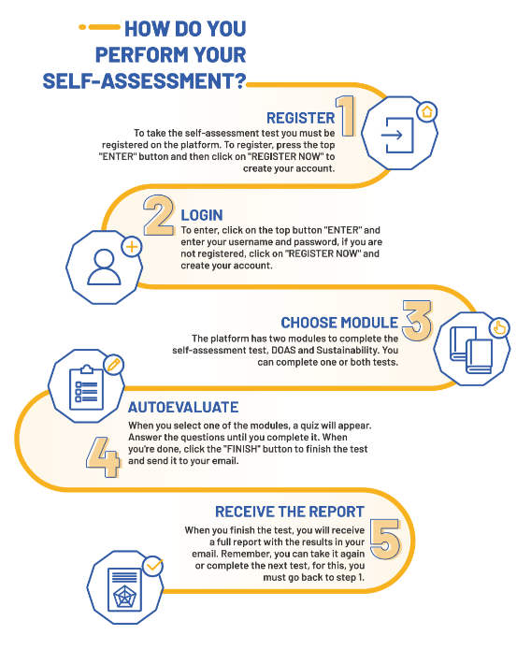
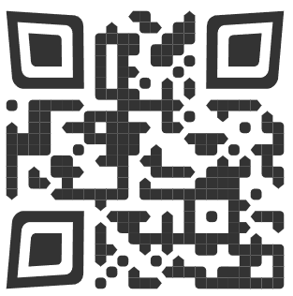
Self-assessment tool
A web-based application for institutional publishers (IPs) and service providers (SPs) enabling them to analyze their level of compliance with the DOAS and sustainability guidelines.
Currently only the DOAS self-assessment module is available.
https://diamas.fecyt.es/

Slide 18
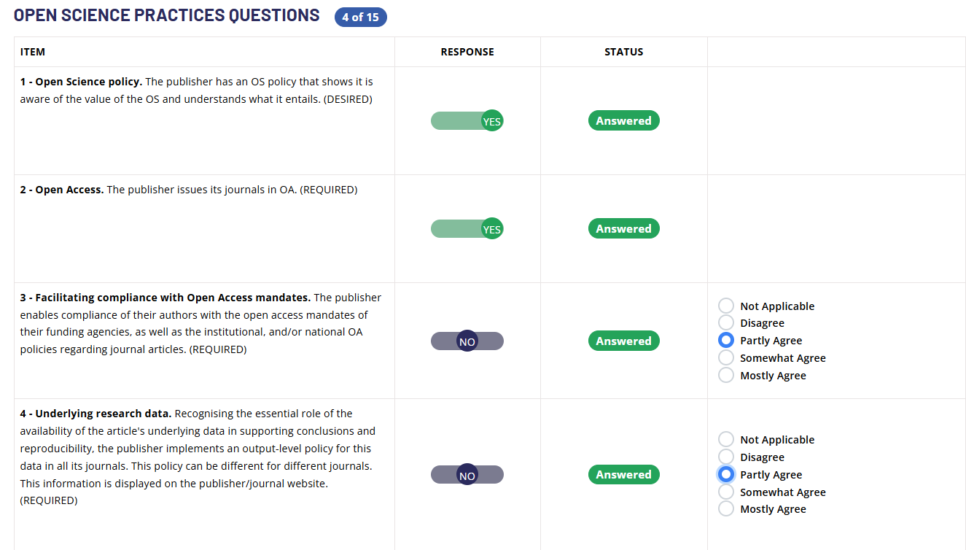
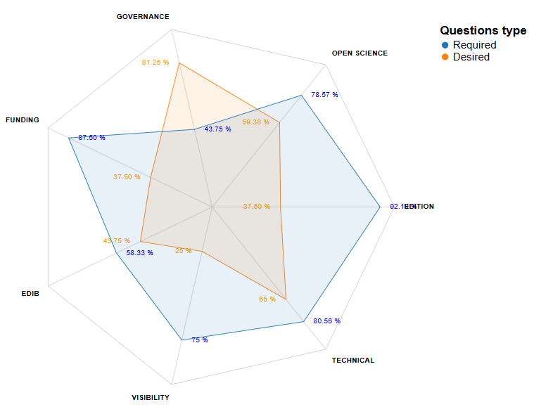
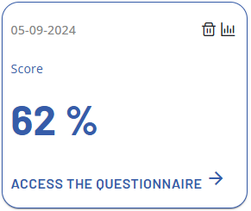
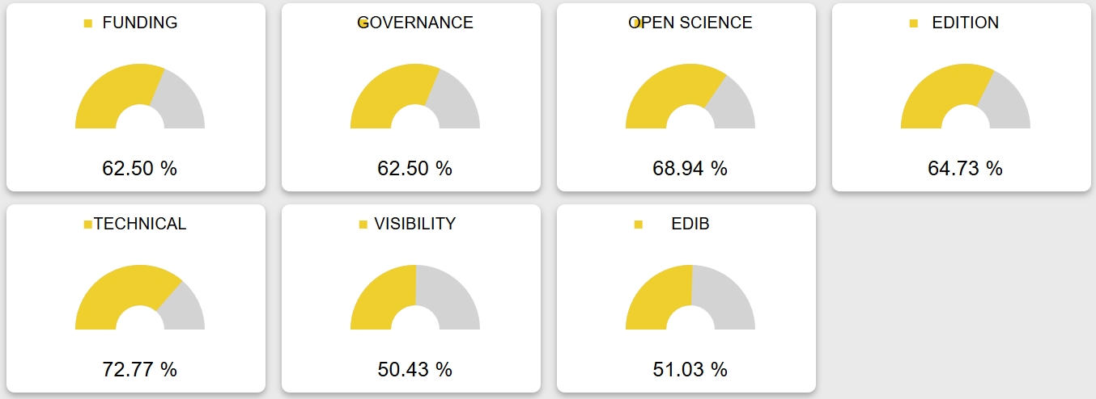

Slide 19
Toolsuite
Topics covered:
Funding
Ownership and governance
Open science practices
Editorial Quality
Editorial management
Research integrity
Technical service efficiency
Software and interoperability
Metadata
Preservation and content formats
Visibility, indexation, communication, marketing and impact
Equity, Diversity and Inclusion
Gender diversity
Accessible/inclusive website, content and metadata
Multilingualism

Slide 20
Guidelines
Topics covered:
Revenue streams
Diamond OA policies
To ensure scholars/community input into governance
General Terms and Conditions
Copyright, author’s right policy
Licensing
Data sharing policy
Preprints
Self-archiving policy
Handling negative research results
Additional documents with publication, including data
Additional documents with publication, including data
Basic editorial information that should be displayed
GDPR and personal data
Choosing a platform
Metadata formats and export, identifiers, CRediT tags, bibliografic references, JATS XML or equivalent
Marketing, communication, visibility
Usage and metrics
Gender
Accessibility
Multilingualism

Slide 21
COMMON ACCESS POINT (CAP)
REGISTRY Publisher & Service Provider profiles, with information on their operations
PORTAL Guided access to components & resources
SELF-ASSESSMENT TOOLS Workflow to evaluate compliance to standards & best practices
FORUM Virtual space to support interaction & knowledge-exchange
TRAINING PLATFORM Scenario-based learning paths and materials
TOOLSUITE Information & support on standards & best practices

Slide 22
Guidelines and recommendations to support Diamond OA publishing

Slide 23
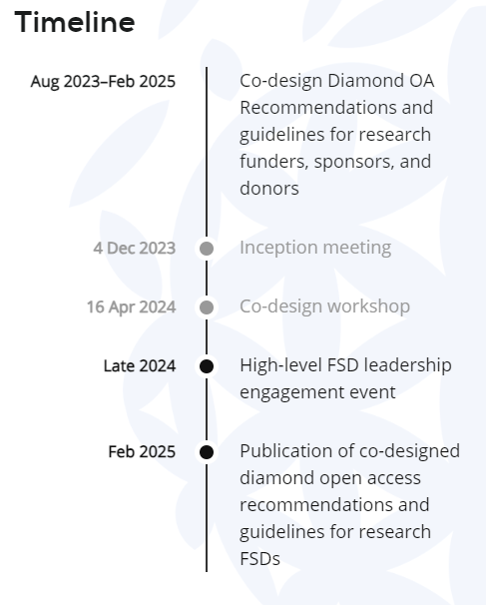
Co-Designing Diamond Open Access Recommendations and Guidelines for Research Funders, Sponsors, and Donors through consultations and workshops
https://scienceeurope.org/events/co-designing-diamond-oa-recommendations-and-guidelines

Slide 24
Diamond OA publishing and research assessment
DIAMAS supports the vision of the Coalition for Advancing Research Assessment CoARA
DIAMAS is developing guidelines and recommendations aimed at supporting Diamond OA publishing
Focus on research integrity and quality in research assessment
Recognition of bibliodiversity, a wide range of Open Science practices and the engagement of researchers in Diamond OA publishing (e.g. as authors, editors or reviewers) for assessment and promotion.
DOAS will help align quality standards in Diamond OA publishing across institutions and countries.
DOAS can be integrated into national frameworks for journal assessment and allocation of funding.

Slide 25
Thank you!
Questions?
Newsletter subscription: DIAMAS
Follow us: @diamasproject
Have a closer look: diamasproject.eu

