Slide 1


Attitudes towards open peer-review in the
Croatian Medical Journal
Ksenija Baždarić¹, Hrvoje Barić ², Mario Malički ³, Svjetlana Kalanj - Bognar ⁴
1 - University of Rijeka, Faculty of Health Studies Rijeka, Croatia, Croatian Medical Journal and European Science Editing
2 - University of Zagreb, Faculty of Medicine ; Department of Neurosurgery, Clinical Hospital Center Zagreb, Zagreb, Croatia and Department of Neurosurgery, Helsinki University Hospital, Helsinki, Finland; Croatian Medical Journal
3 - Stanford Program on Research Rigor and Reproducibility (SPORR), Stanford University Stanford, CA, USA
4 - University of Zagreb School of Medicine, Croatian Medical Journal, Zagreb, Croatia

Slide 2

Open peer-review
‘’an umbrella term for a number of overlapping ways that peer review models can be adapted in line with the aims of Open Science, including making reviewer and author identities open, publishing review reports and enabling greater participation in the peer review process’’.
Ross-Hellauer T. What is open peer review? A systematic review. F1000Res. 2017;6:588. doi: 10.12688/f1000research)

Slide 3
Open peer-review traits
Open identities: Authors and reviewers are aware of each other’s identity
Open reports: Review reports are published alongside the relevant article.
Open participation: The wider community to able to contribute to the review process.
Open interaction: Direct reciprocal discussion between author(s) and reviewers, and/or between reviewers, is allowed and encouraged.
Open pre-review manuscripts: Manuscripts are made immediately available (e.g., via pre-print servers like arXiv) in advance of any formal peer review procedures.
Open final-version commenting: Review or commenting on final “version of record” publications.
Open platforms (“decoupled review”): Review is facilitated by a different organizational entity than the venue of publication.
Ross-Hellauer T. What is open peer review? A systematic review. F1000Res. 2017;6:588. doi: 10.12688/f1000research

Slide 4
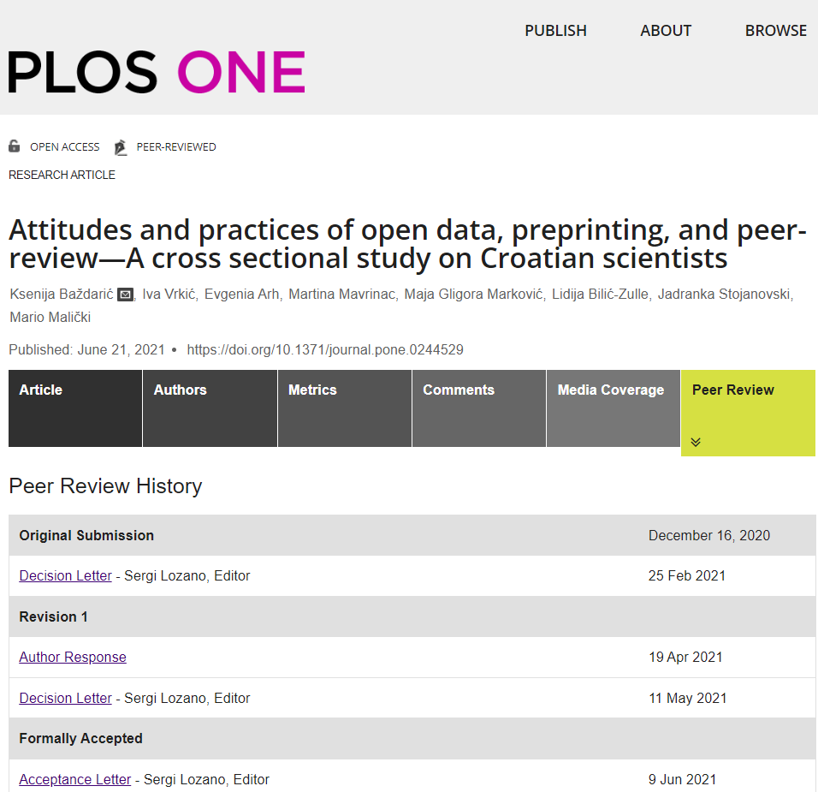
Open reports
PLOS ONE
16% of open peer-review reports

Slide 5
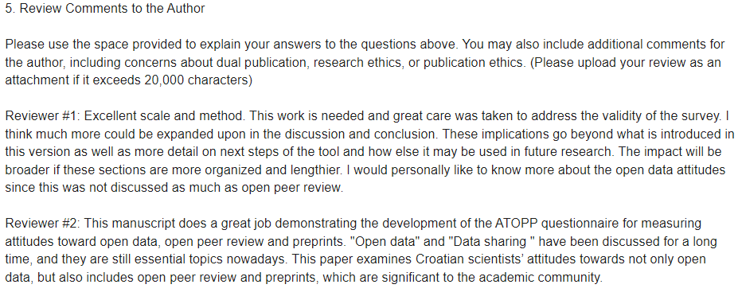
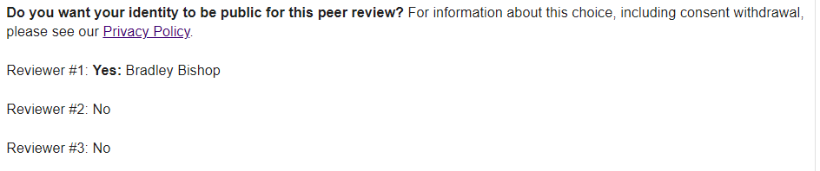
Open reports and open identities - PLOS ONE
https://journals.plos.org/plosone/article/peerReview?id=10.1371/journal.pone.0244529

Slide 6
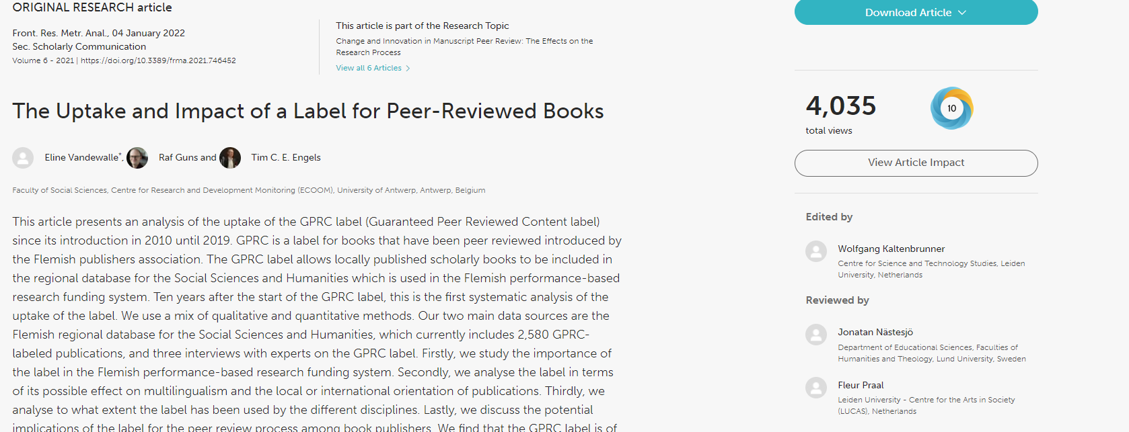
Open interaction – Frontiers
Notes:
U prosjeku 61 dan

Slide 7
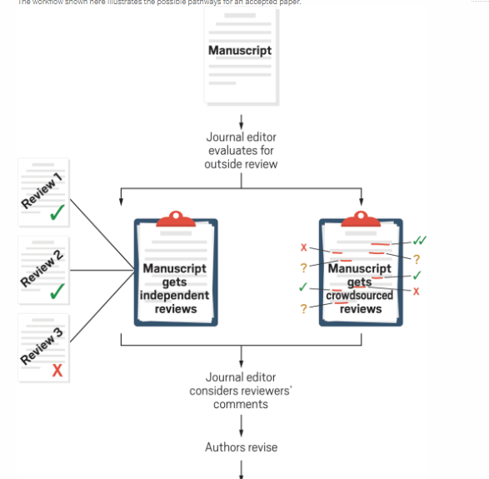
Open participation– Crowd Peer Review - Synlett
20-70 comments up to 16 reviewers in 4 days
From submission to publishing in 22 days
Notes:
That’s why SYNLETT offers Select Crowd Review (SCR) as an additional option to traditional peer review.
Opting for SCR, you will receive reviews within 4 days which is less than half of the duration of traditional peer review.
On average, the reviews consist of 20–70 comments per paper submitted by up to 16 reviewers. The entire publication process using SCR takes ~22 days compared to ~34 days using traditional peer review.

Slide 8
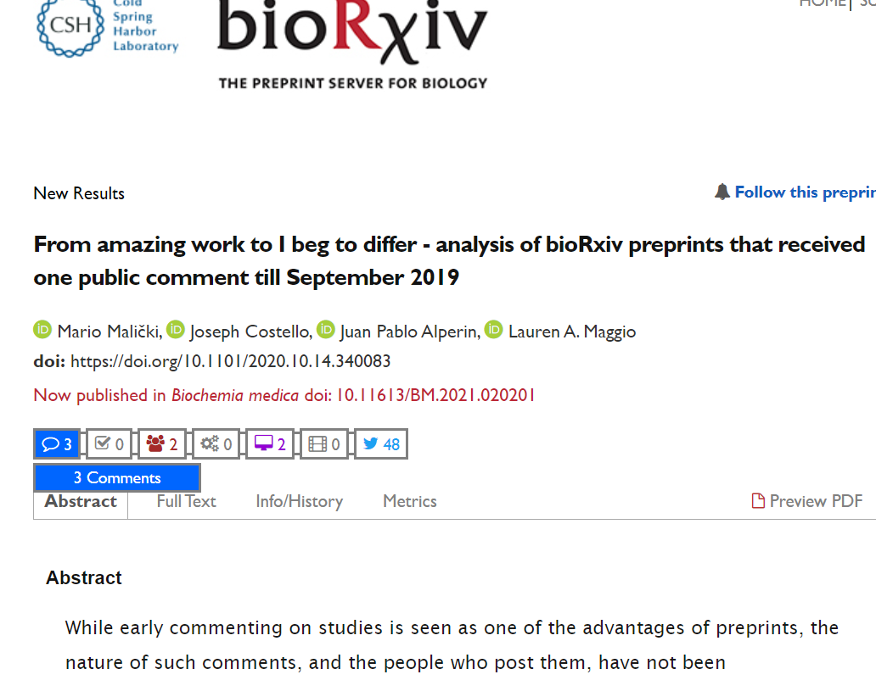
Open pre-review manuscripts
https://www.biorxiv.org/content/10.1101/2020.10.14.340083v1

Slide 9

Open final-version commenting - European Science Editing

Slide 10
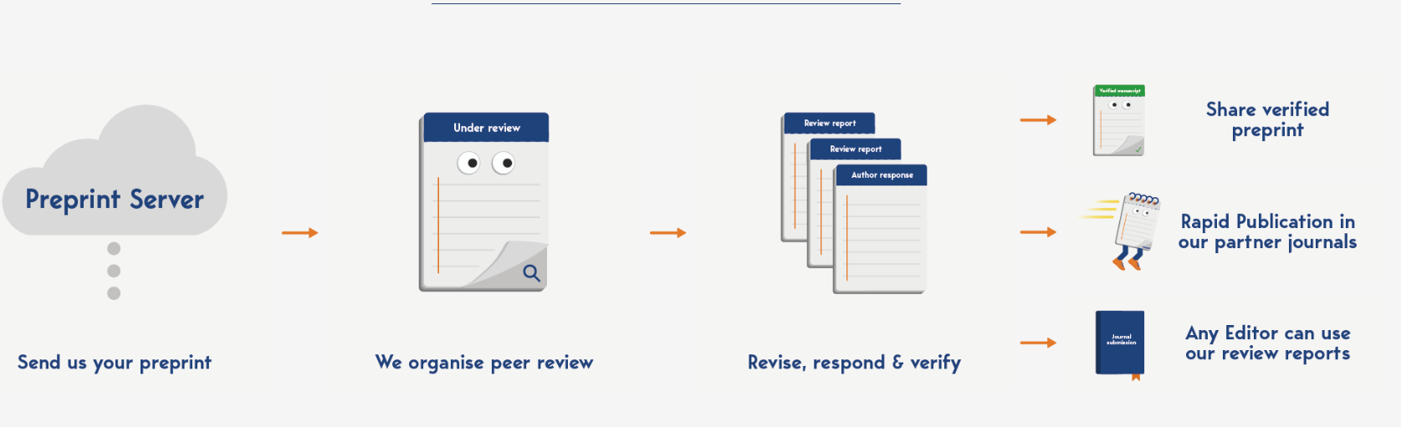
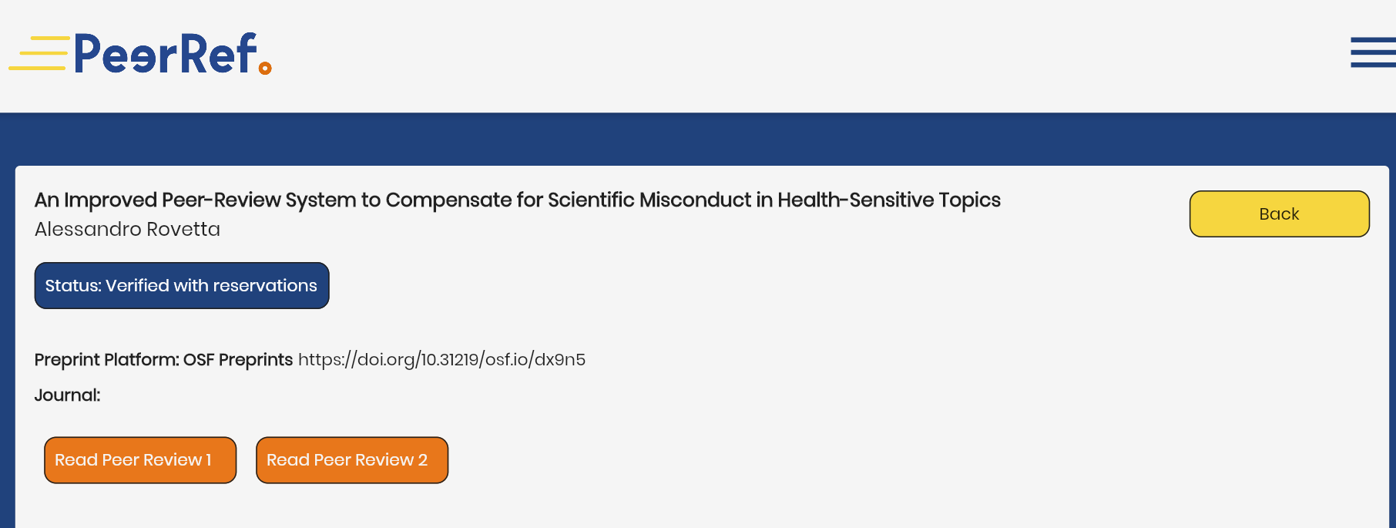
Open platforms–PeerRef (before submit)

Slide 11
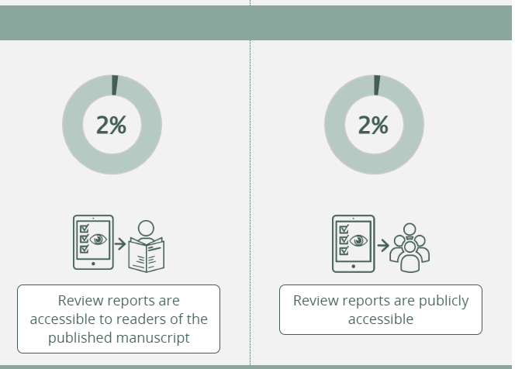
Open peer-review reports statistics
https://www.responsiblejournals.org/database/statistics

Slide 12
Attitudes towards open peer-review (OPR)
2001. - 17% (n=103) reviewers of Food Science and Technology International would like open peer-review (1 question). Melero R, López-Santoveña F. Referees’ Attitudes toward Open Peer Review and Electronic Transmission of Papers. Food Sci Technol Int. 2001;7(6):521–7.
2010.- 28% (n=364) reviewers of a general danish medical journal prefer OPR (1 pitanje) Vinther S, Nielsen OH, Rosenberg J, Keiding N, Schroeder T V. Same review quality in open versus blinded peer review in “Ugeskrift for Læger”. Dan Med J. 2012;59(8). pmid:22849979
2017. - Ross-Hellauer, Deppe and Shmidt (n=3000), European participants (61%), STEM (90%), mostly postitive attitude towards OPR, but negative towards open identities (Ross-Hellauer T, Deppe A, Schmidt B. Survey on open peer review: Attitudes and experience amongst editors, authors and reviewers. PLoS One. 2017;12(12):1–28.
2021. – Bazdaric et al (2021): croatian scientists (n=541), validated questtionnaire: Attitudes towards open data sharing, preprinting, and peer-review (ATOPP) questionnaire: neutral attitude towards OPR and negative towards OPR in a small scientific community (Baždarić K, Vrkić I, Arh E, Mavrinac M, Gligora Marković M, Bilić-Zulle L, Stojanovski J, Malički M. Attitudes and practices of open data, preprinting, and peer-review-A cross sectional study on Croatian scientists. PLoS One. 2021;16(6):e0244529. doi: 10.1371/journal.pone.0244529. )

Slide 13

Aim
to investigate attitudes and practices of open peer review of authors, reviewers and editors of the Croatian Medical Journal (CMJ), an indexed diamond open access journal.

Slide 14
Materials and Methods
We have used the validated ATOPP questionnaire* (Attitudes and practices of open data, preprinting, and peer-review, 21 items, 4 factors; α=0,80) and added extra questions in relation to the Croatian Medical Journal
41 questions (21 attitudes on Likert scale 1-5; 9 open science practices, 11 demography and publishing).
The open peer-review scale has 8 items and 2 factors – open peer-review (6 questions; α =0,83) and open-peer review in small scientific community (2 questions, α =0,92).
Participants: authors, reviewers and editors in CMJ (~4200 e-mails)
Baždarić K, Vrkić I, Arh E, Mavrinac M, Gligora Marković M, Bilić-Zulle L, Stojanovski J, Malički M. Attitudes and practices of open data, preprinting, and peer-review-A cross sectional study on Croatian scientists. PLoS One. 2021;16(6):e0244529. doi: 10.1371/journal.pone.0244529.

Slide 15
Participants
n=254 (6% RR); 50% female
Age median 50 (min 27- max 83) y
37 countries: Croatia (54%), Serbia (6%), Slovenia (6%) and others (44%)
Status: full professor (32%), Assoc Prof (25%), Asst prof (18%), Post doc (9%), research fellow (9%), other (7%).

Slide 16
Open peer-review practices
81% no consequences after the signed review
3% negative consequences
6% positive consequences

Slide 17
Attitude towards open peer-review
No gender differences (P=0.254 and P=0.719)
No education differences (P=0.056 and P=0.226)
results (<2.6): negative attitude,
2.6–3.39: neutral attitude
>3.39: positive attitude
C(25-75): 3.2 (2.7-3.8) 2.0 (1.5-3.0)
Notes:
Participants’ attitudes towards open peer review were neutral (median score 3.2 (25 percentile 2.7-75th percentile 3.8) while their attitudes toward open peer review in small scientific community were negative (median 2.3 (25 percentile 1.5-75th percentile 3.0). There were no gender differences in both constructs (P=0.259 and P=0.719, respectively

Slide 18
Attitude towards open peer review and open identities in journals

Slide 19
Attitude towards open peer review and open identities in project proposals

Slide 20
Would you like CMJ to introduce?

Slide 21
Conclusion
Attitudes of authors, reviewers and editors towards OPR are neutral →more OS education
OPR enables transparency, inclusiveness, trust in the journal and quality control of editors, reviewers and authors
Guidelines for open peer review implementation
(https://researchintegrityjournal.biomedcentral.com/articles/10.1186/s41073-019-0063-9)

Slide 22
DO YOU HAVE ANY COMMENTS/ANSWERS FOR ME?

